Slide 1
 | Age (yrs) | Gender | Education (yrs) | MoCA
Younger Adults (n=31) | 23.65 (2.86) | 54.80% female (n=17) | 15.90 (2.27) | N/A
Older Adults (n=27) | 73.44 (7.06) | 51.90% female (n=14) | 15.30 (3.69) | 28.11 (1.01)
Data from first 8 blocks used consistently across block and trial-level analyses.

Slide 2
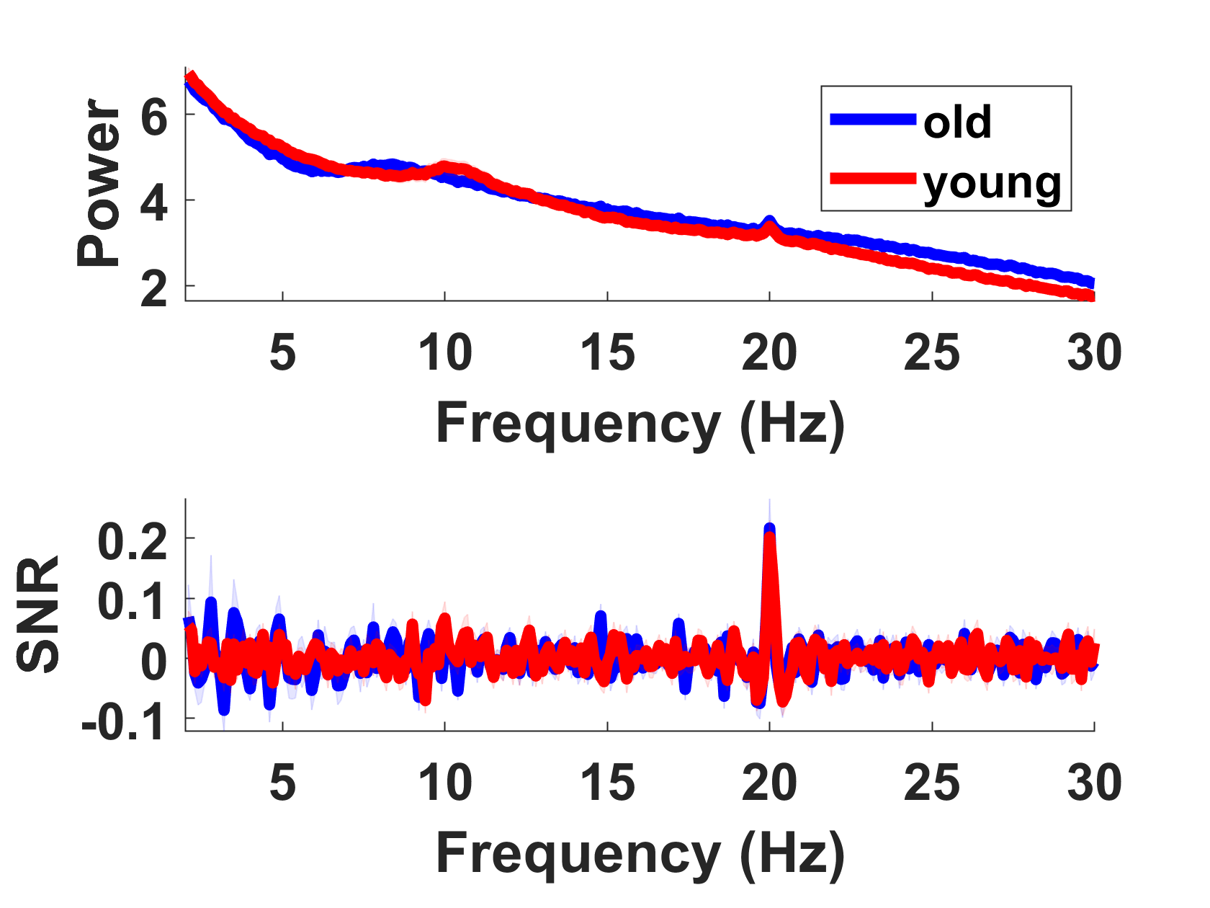
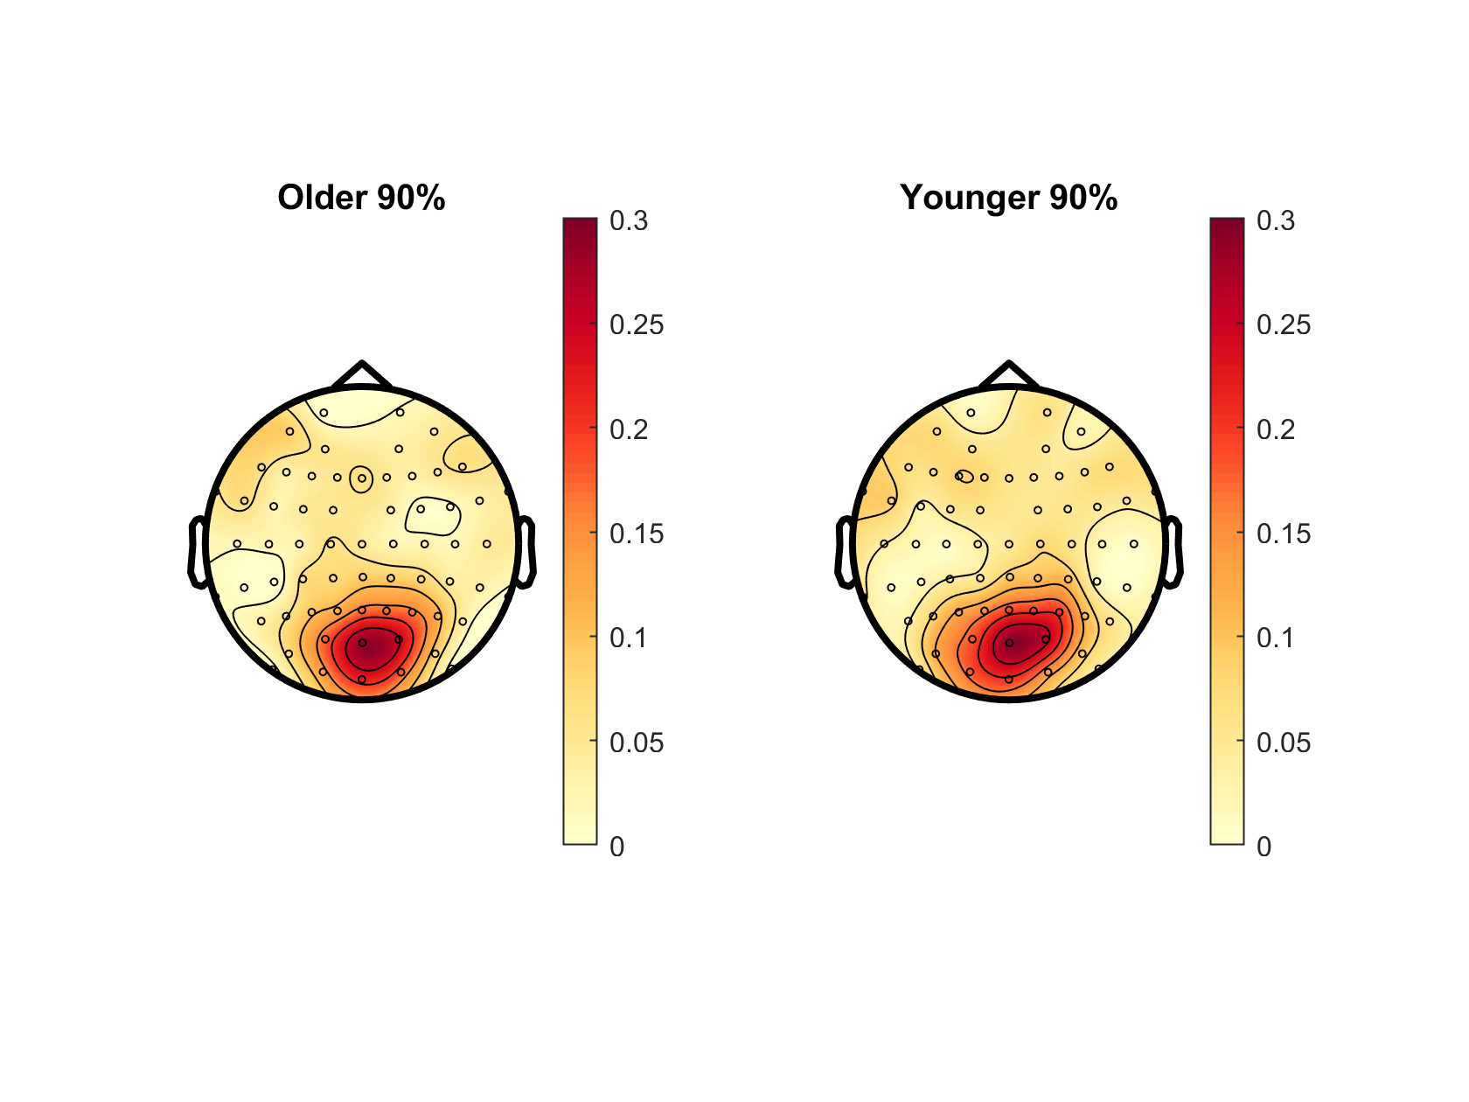
Notes:
? Slightly different to Oz PSD in plotPowerSpec script

Slide 3
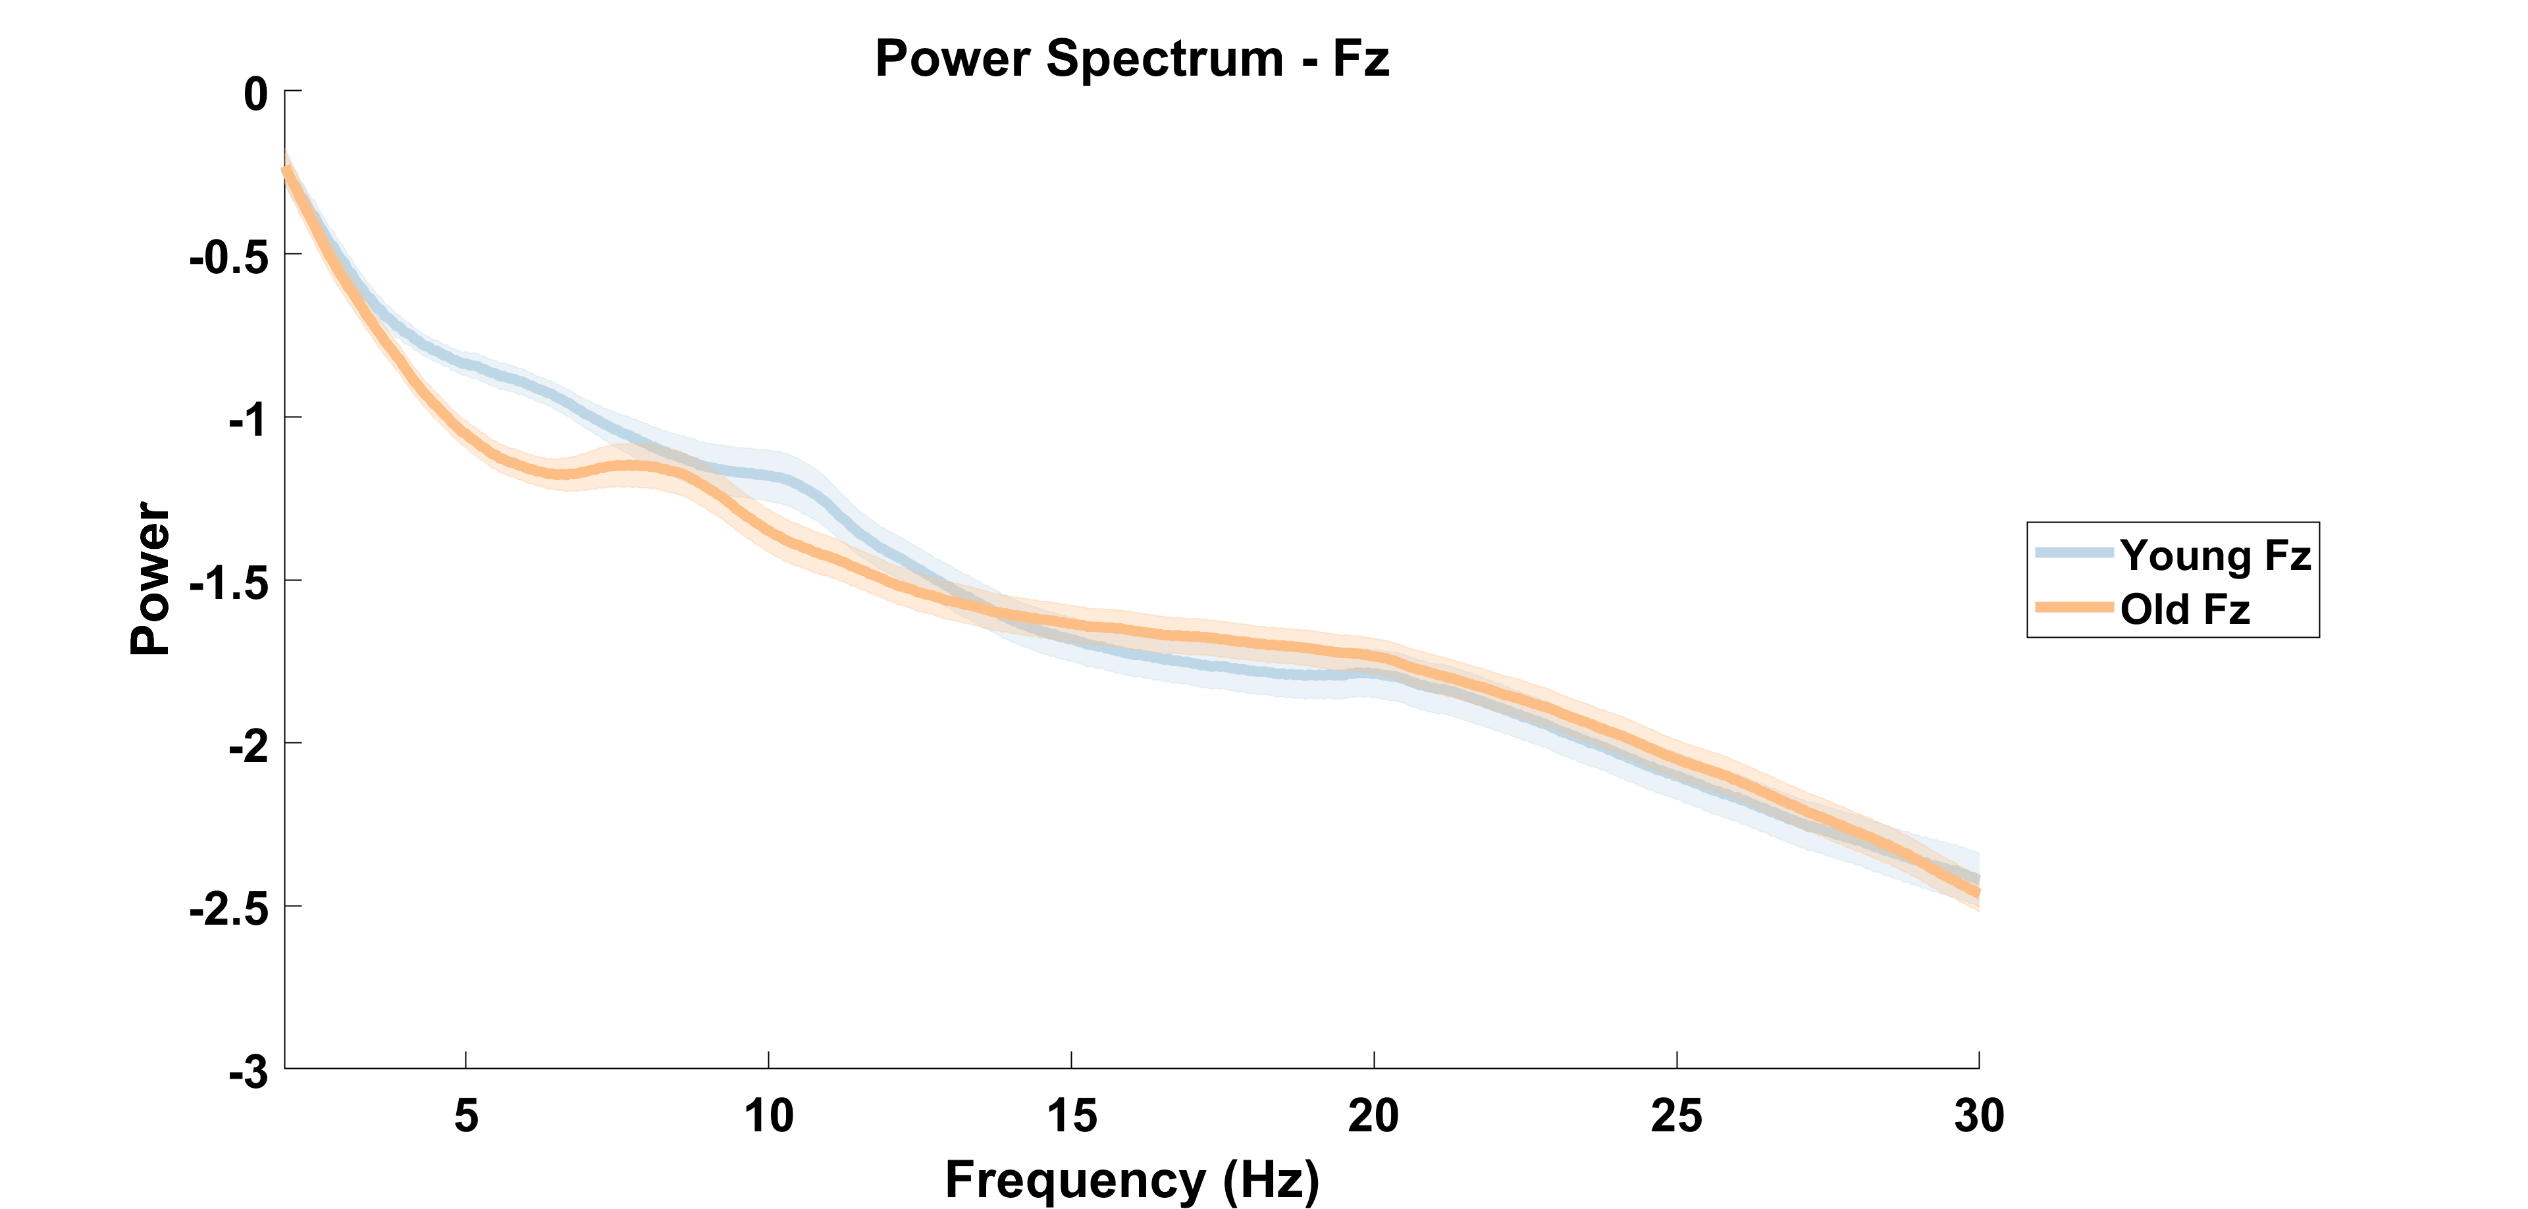

Slide 4
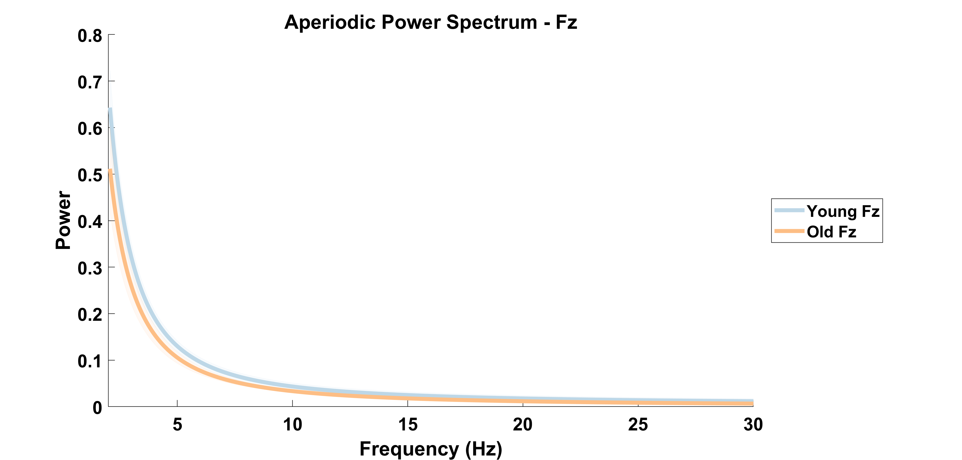

Slide 5
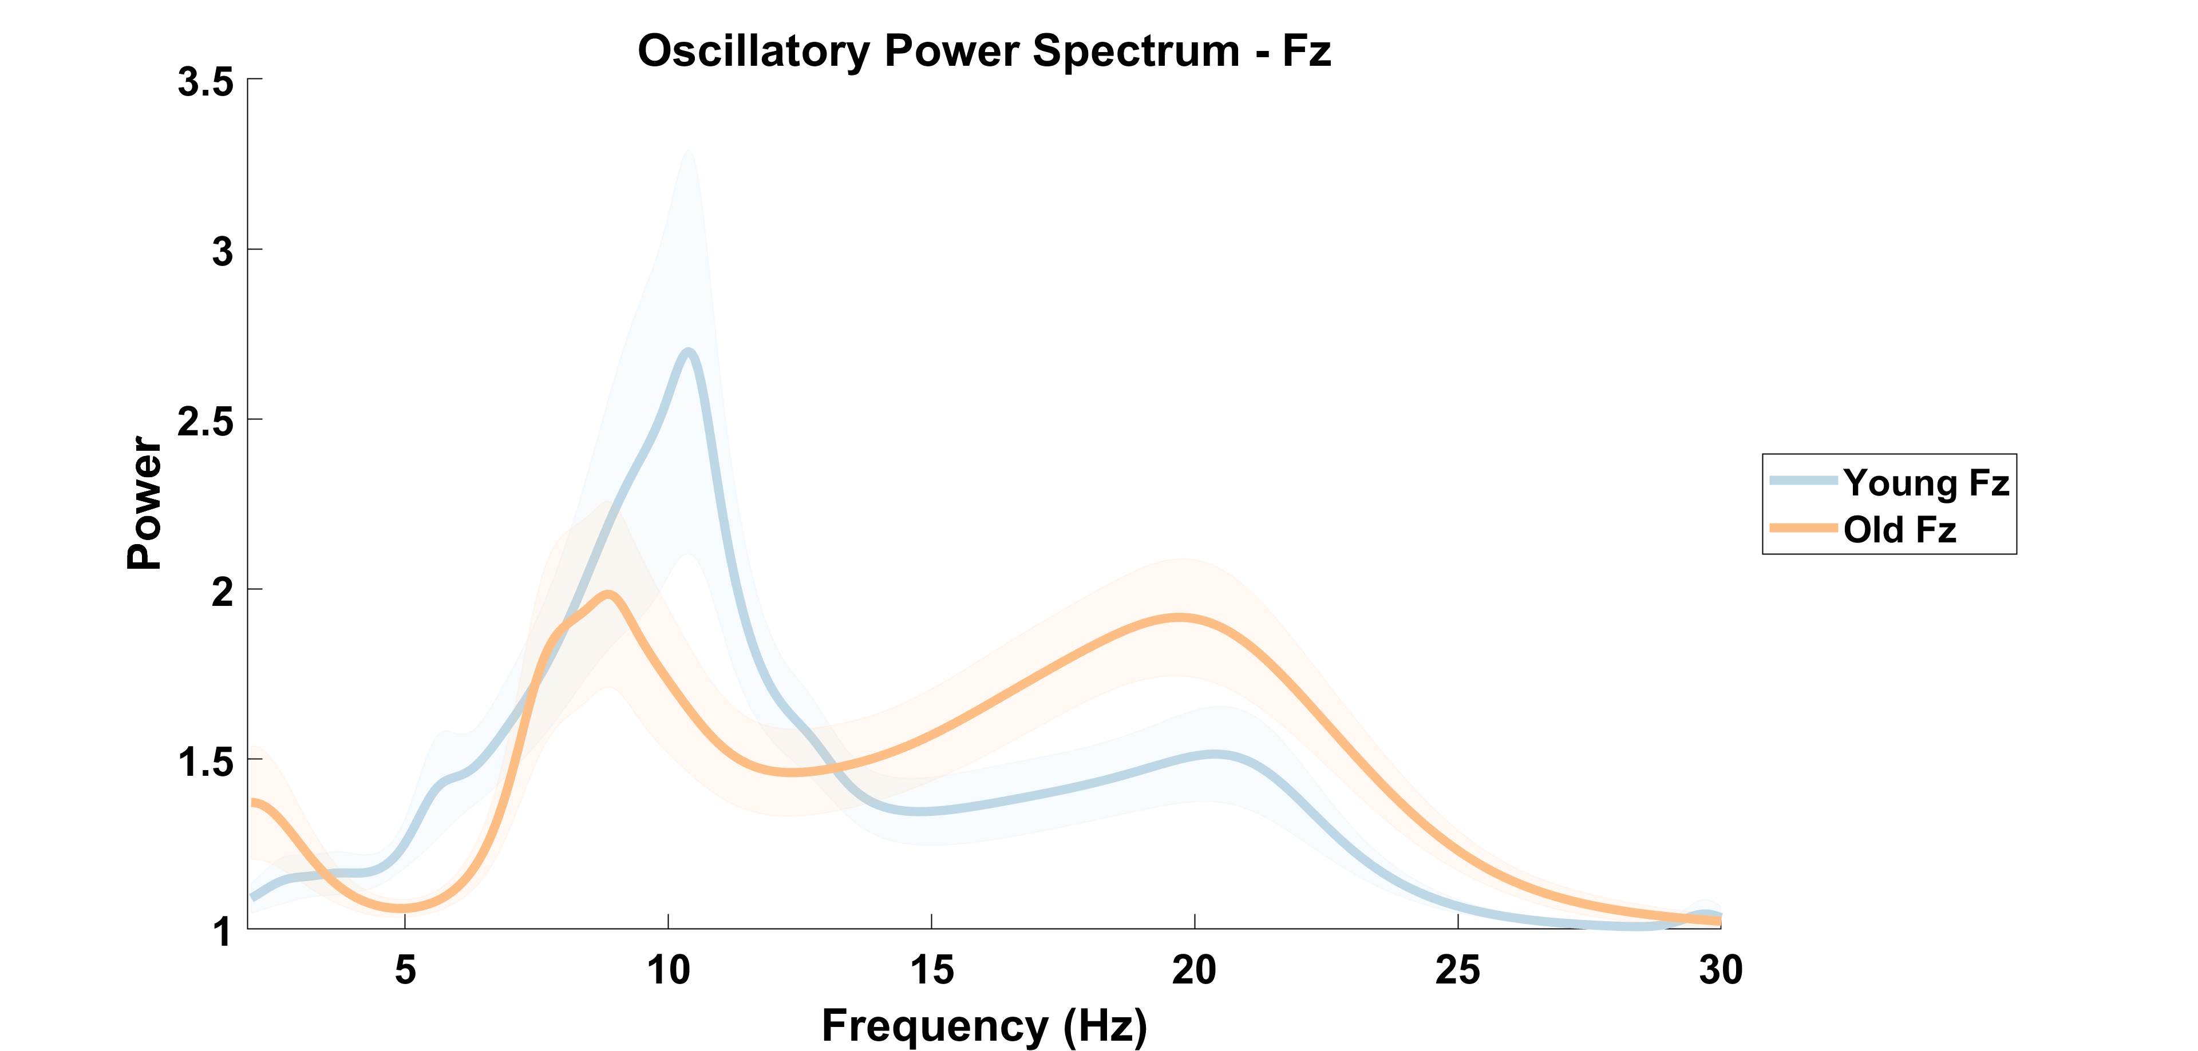

Slide 6
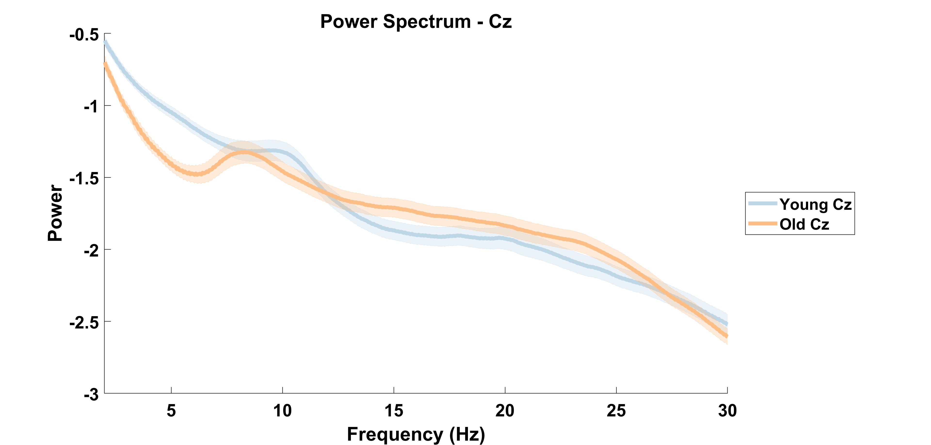

Slide 7
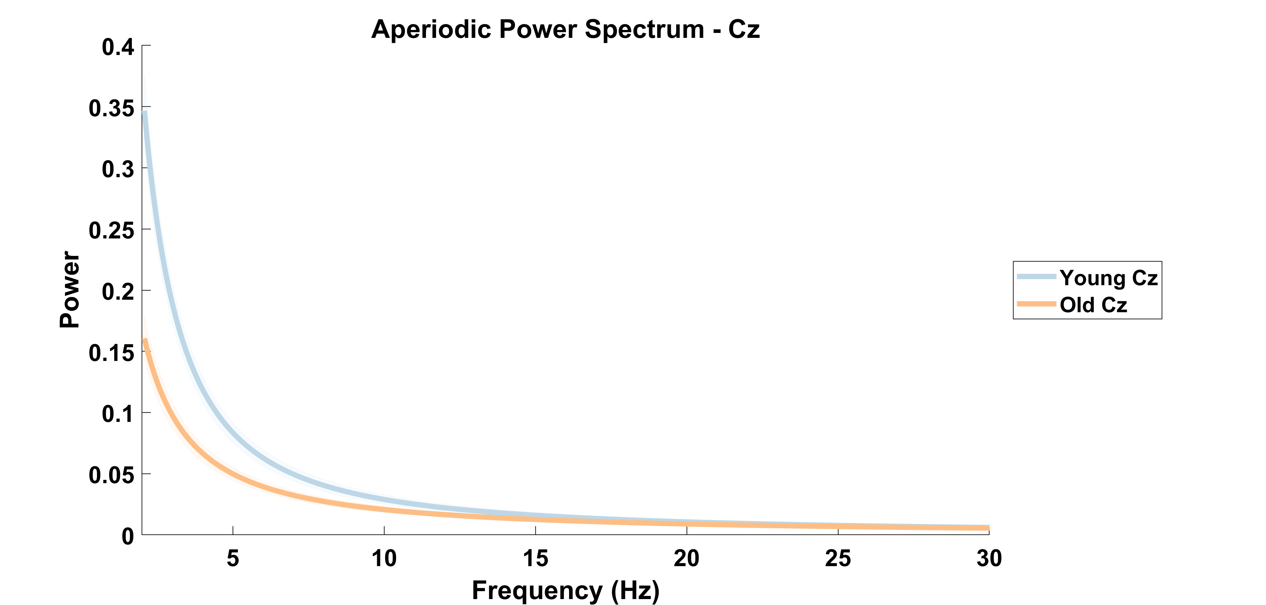

Slide 8
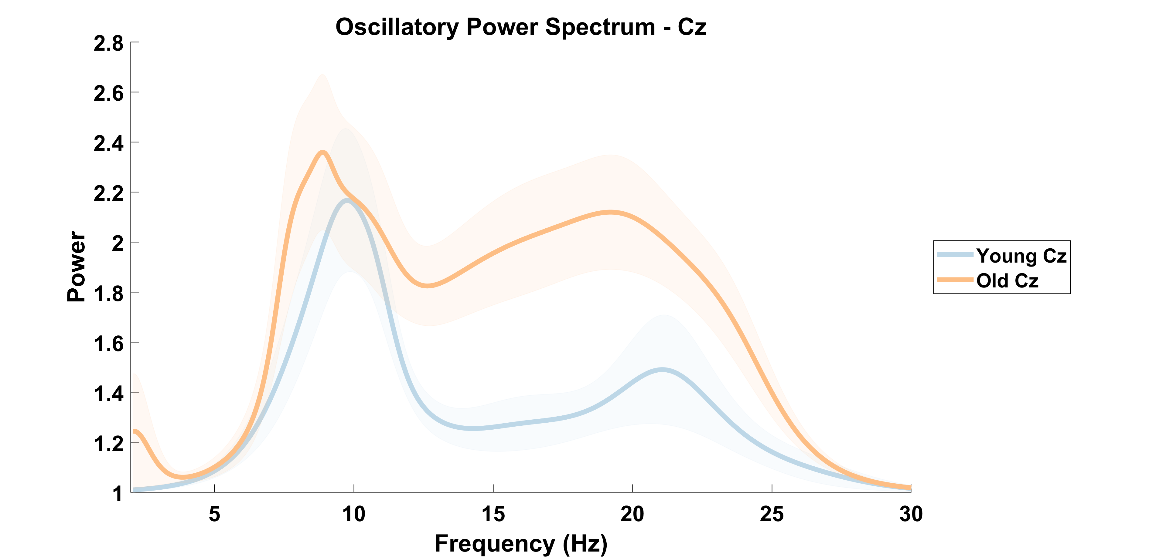

Slide 9
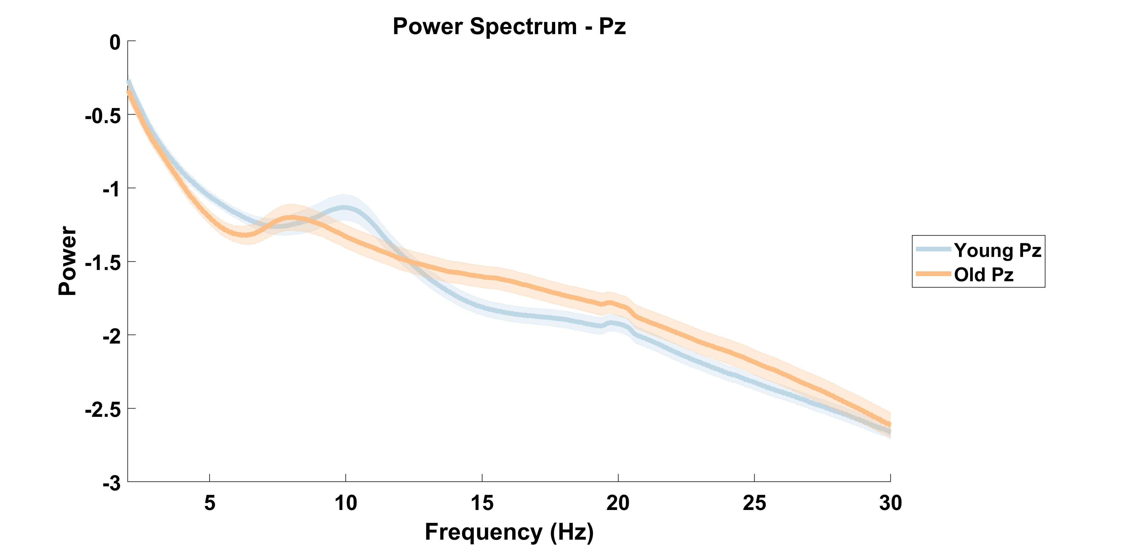

Slide 10
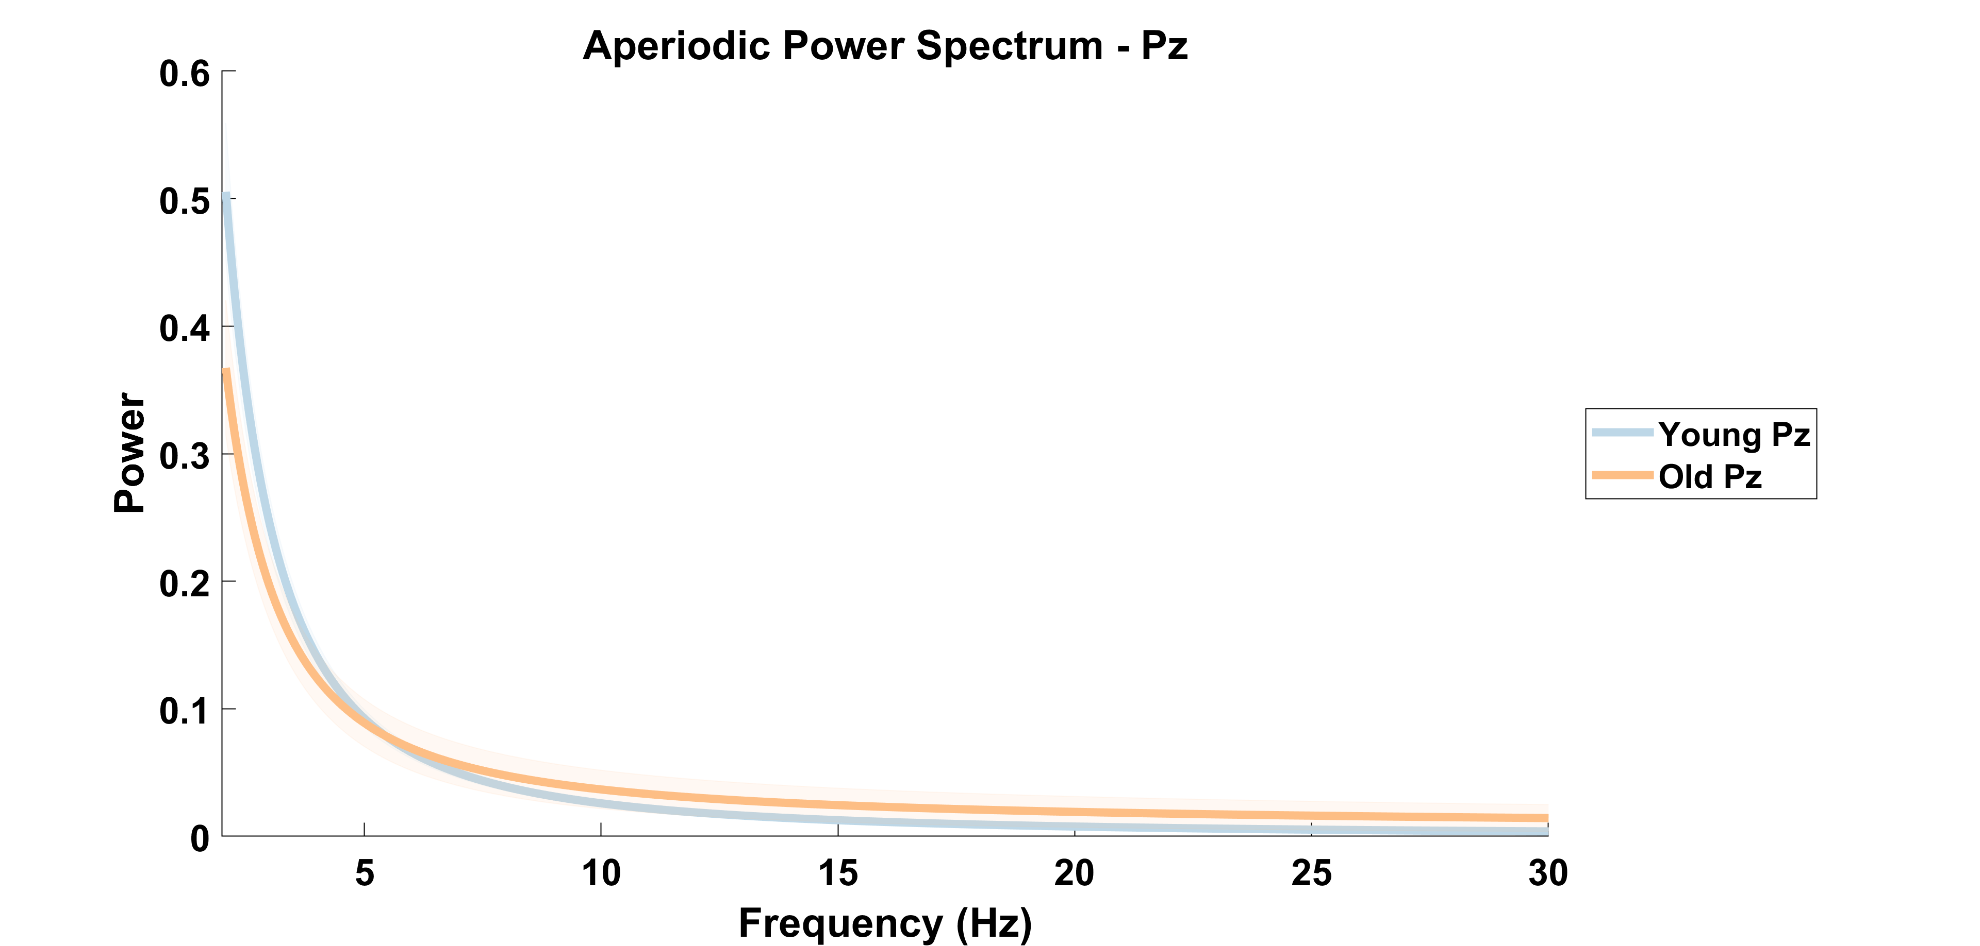

Slide 11
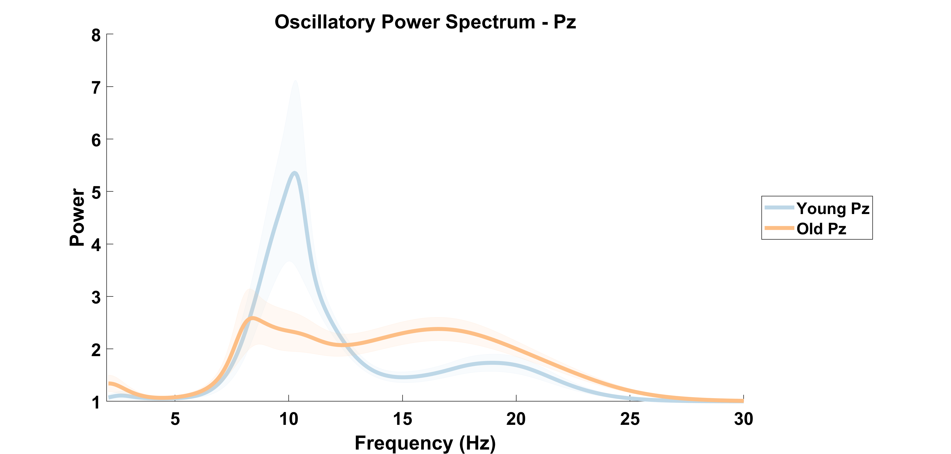

Slide 12
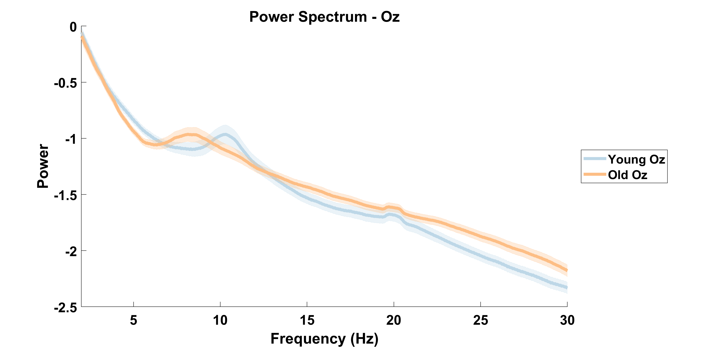

Slide 13
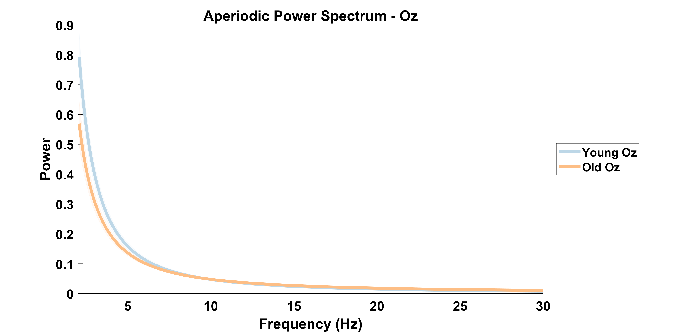

Slide 14
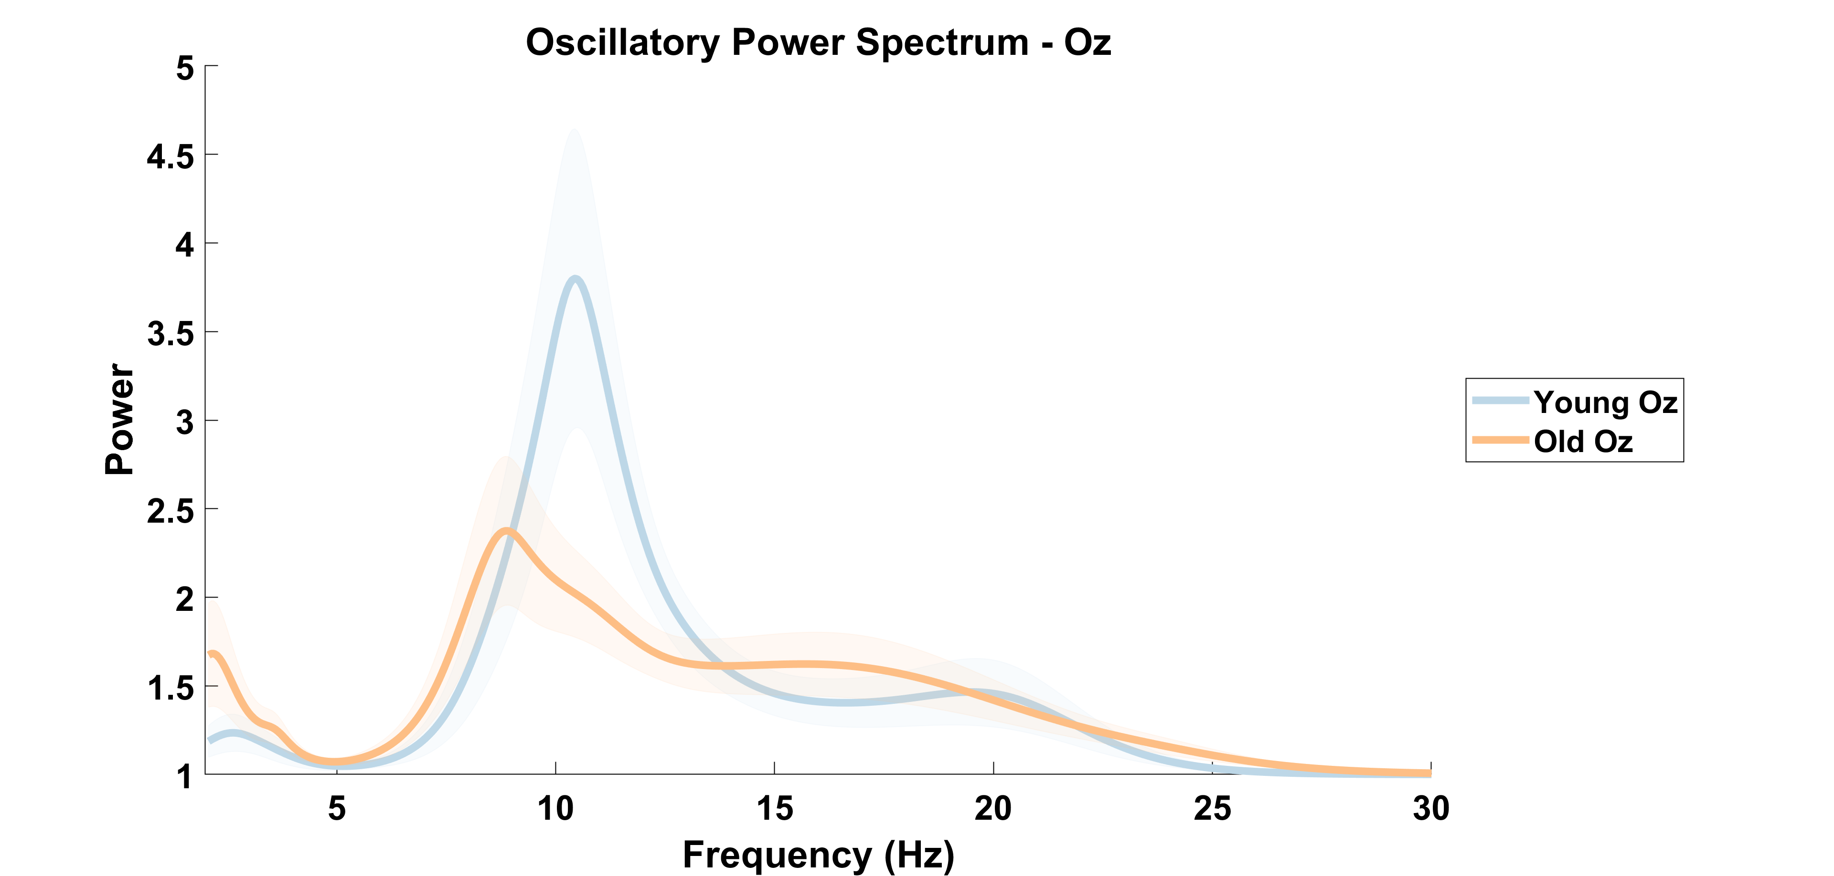

Slide 15
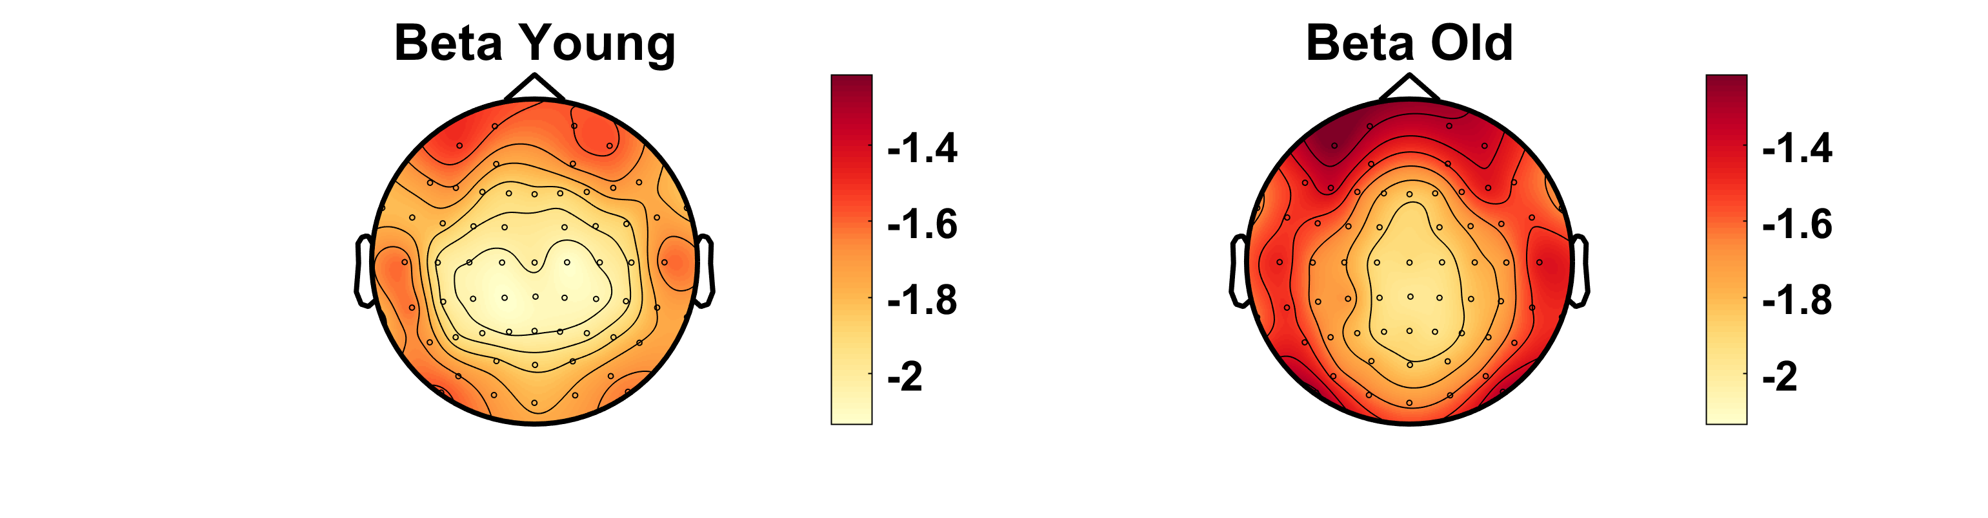
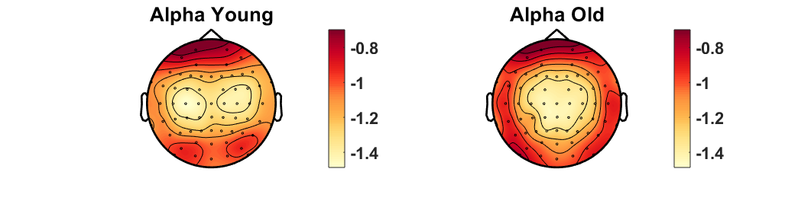
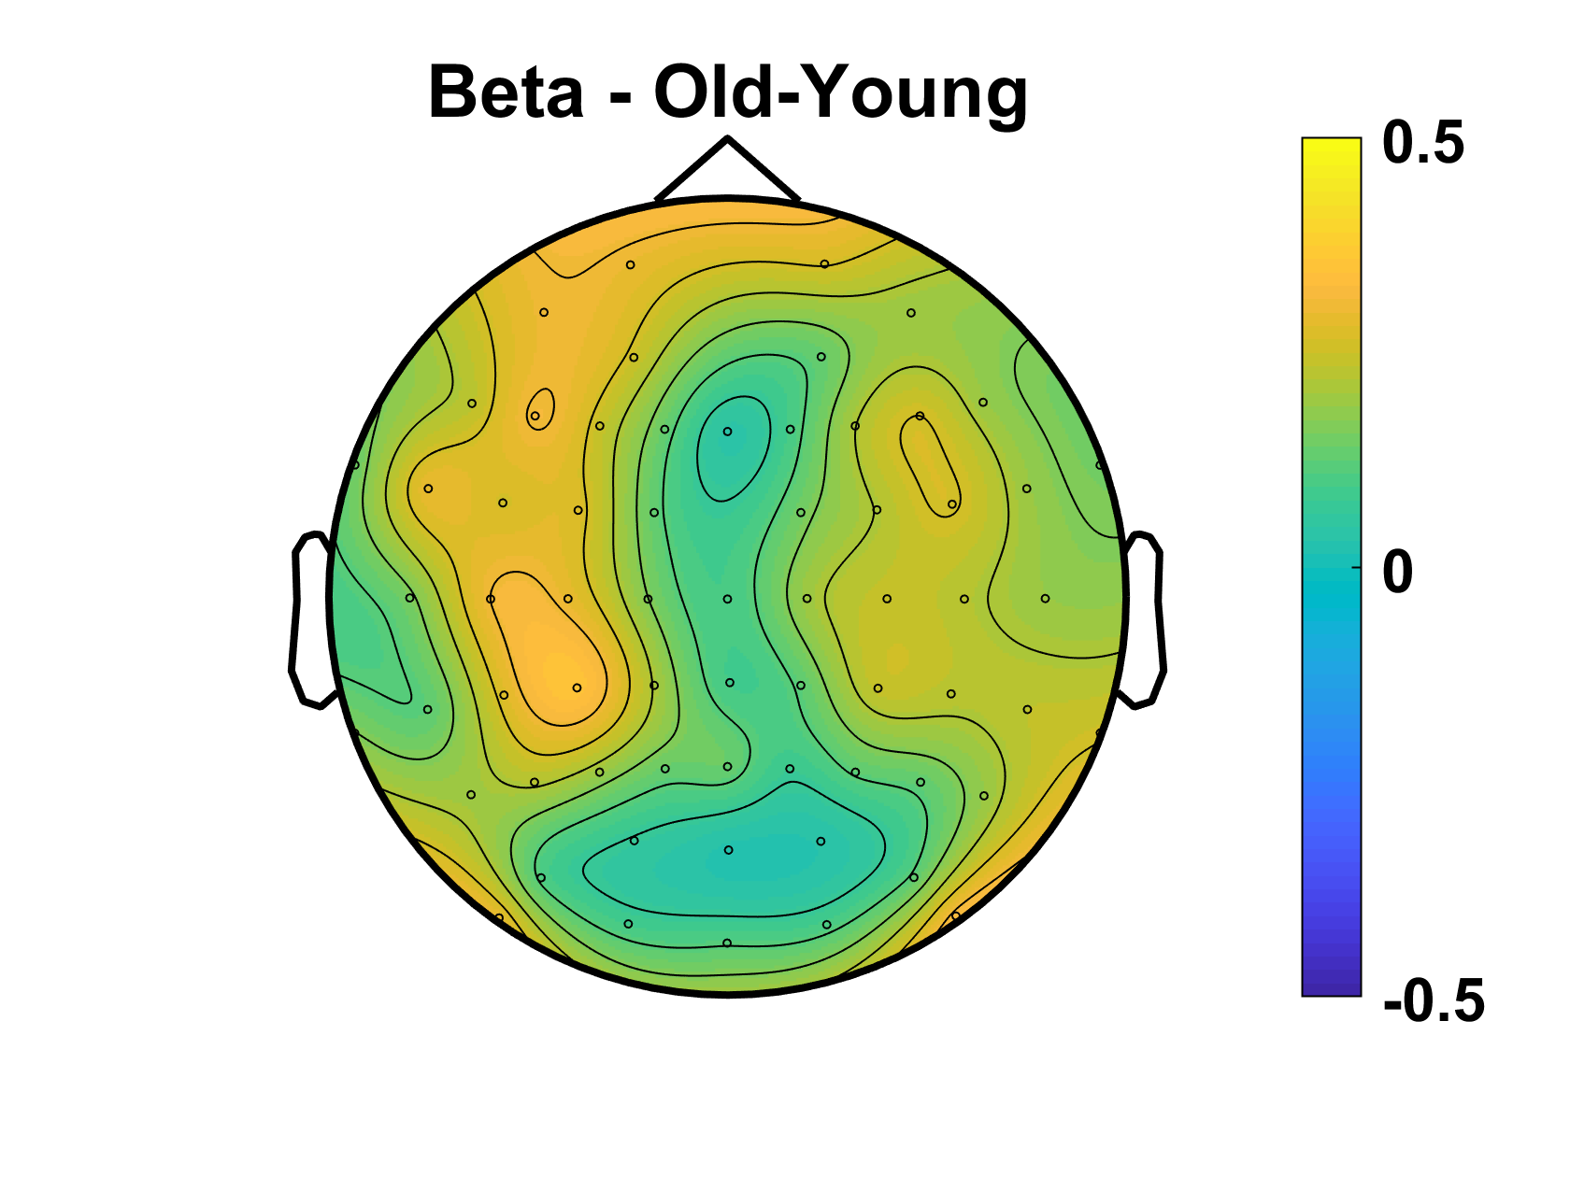
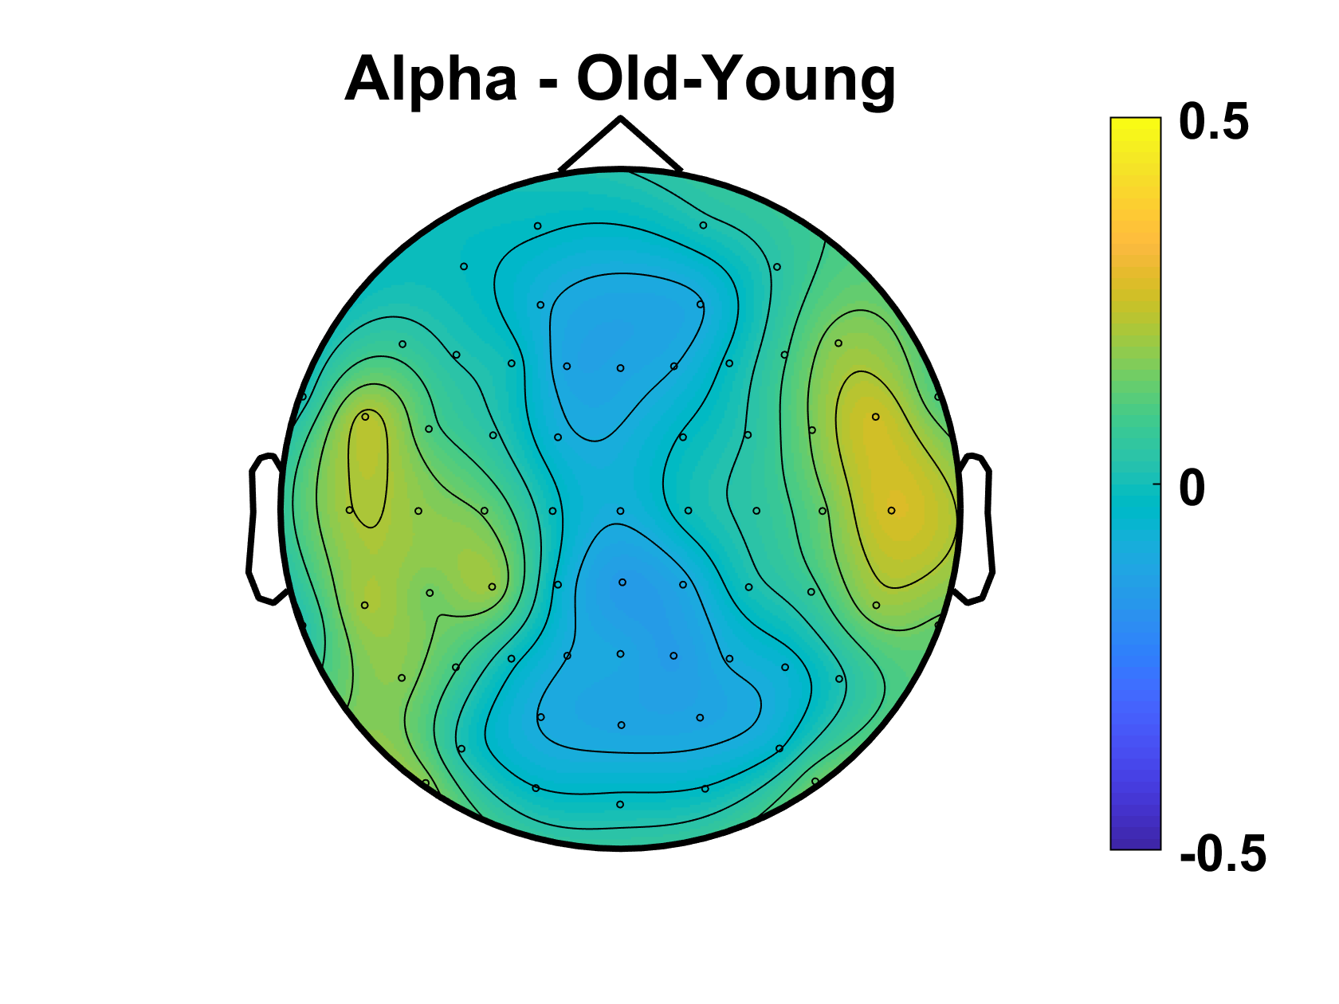
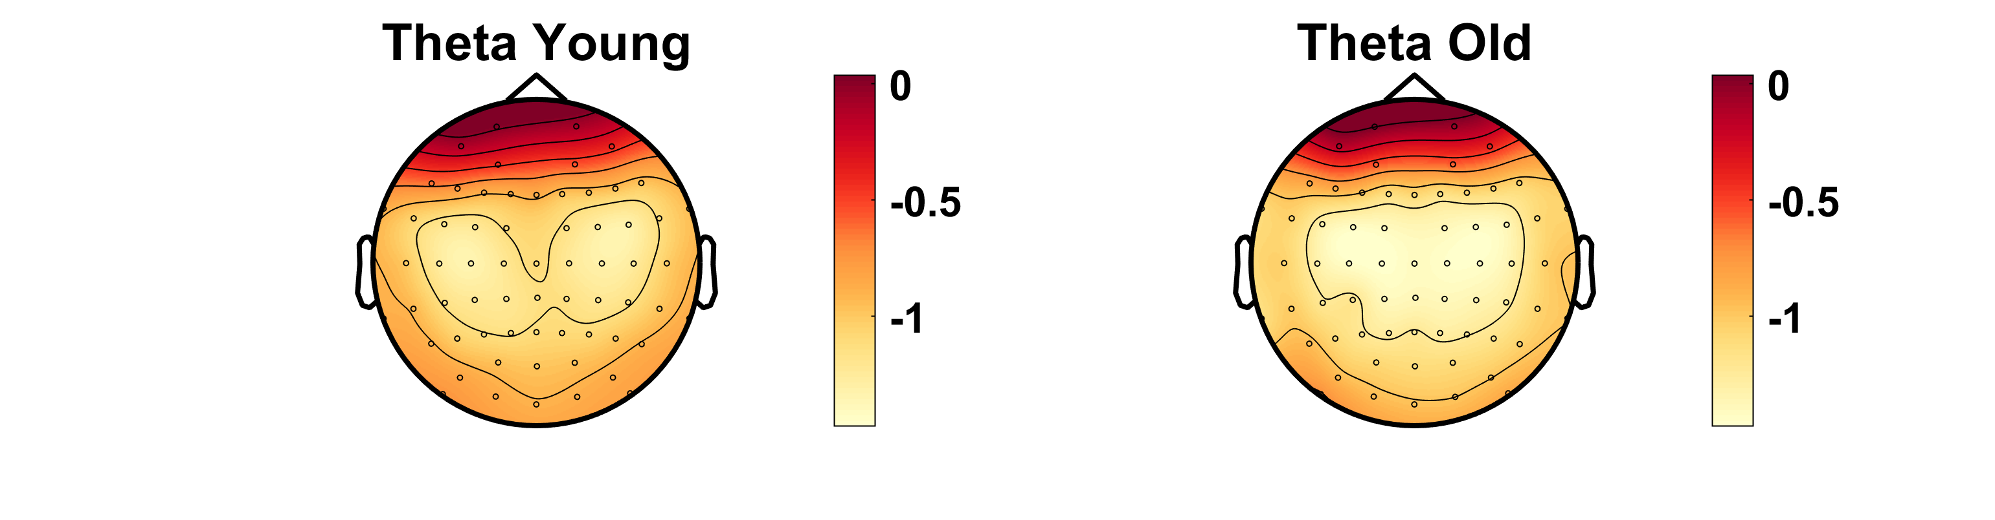
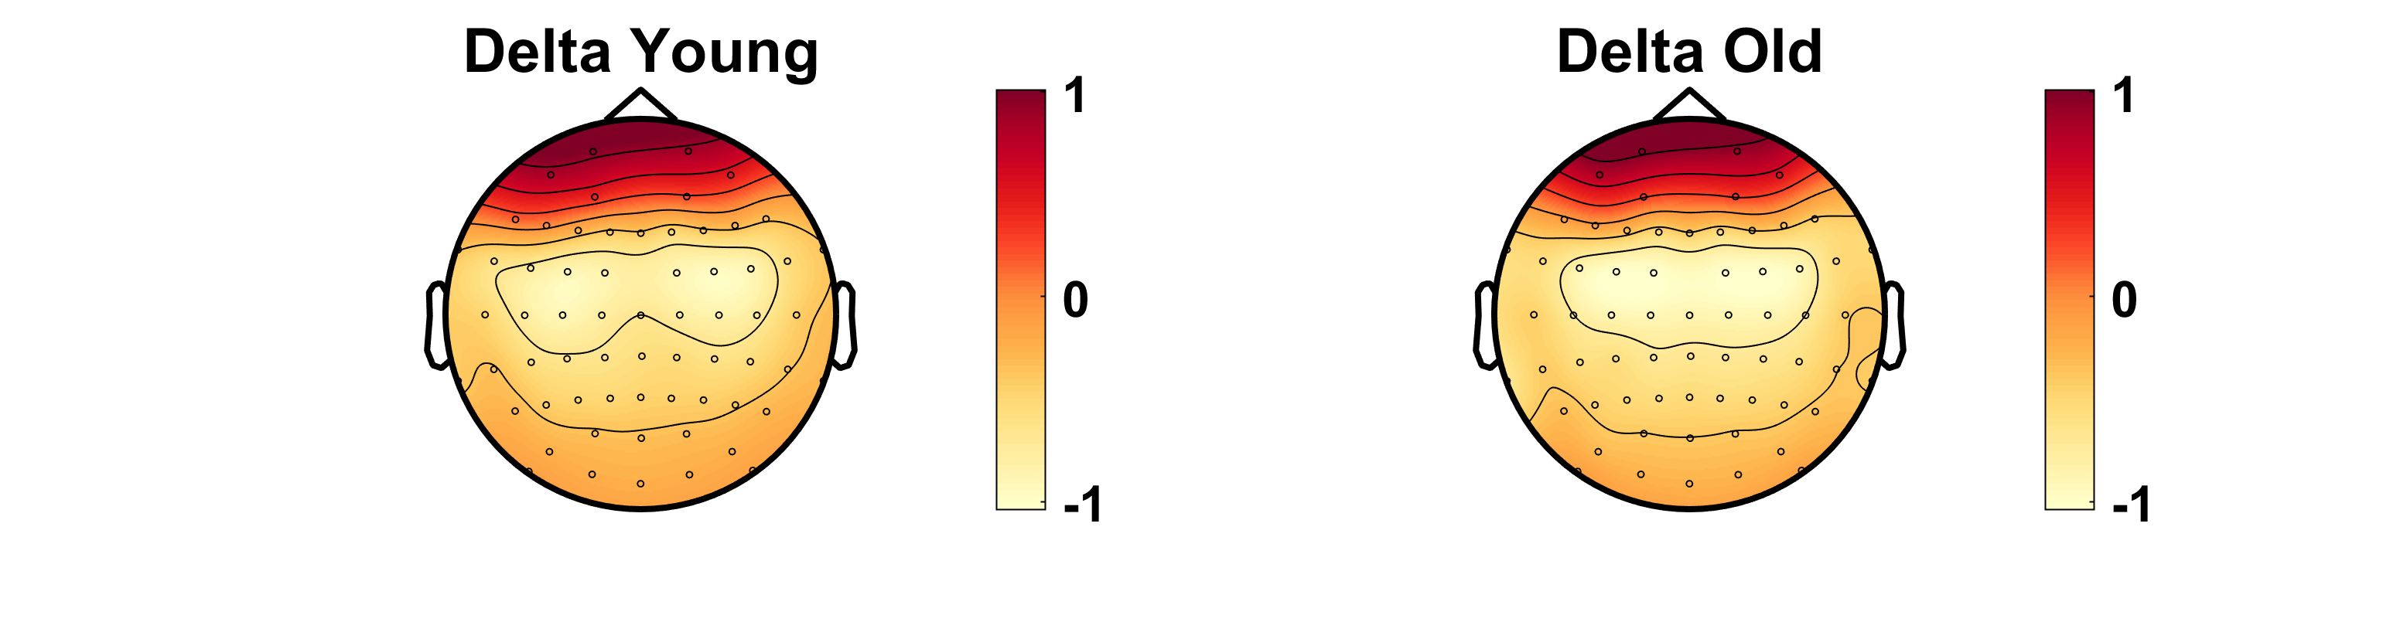
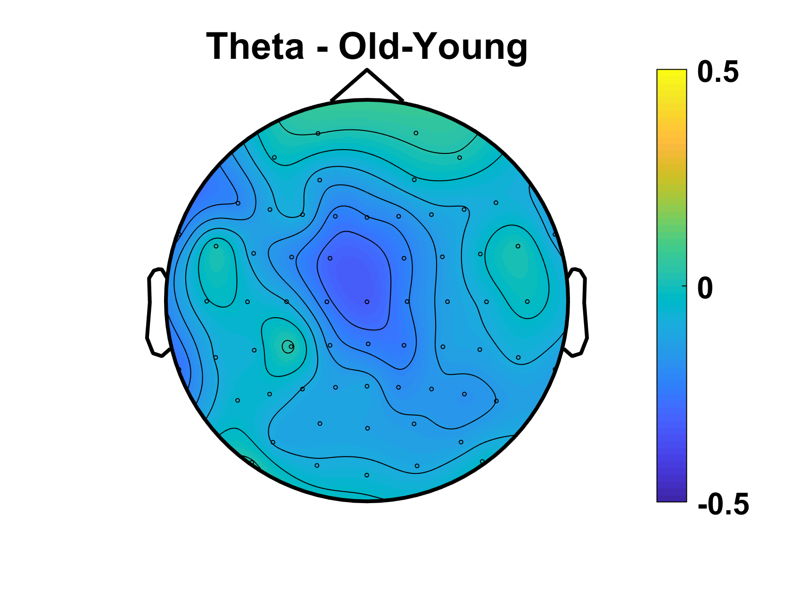
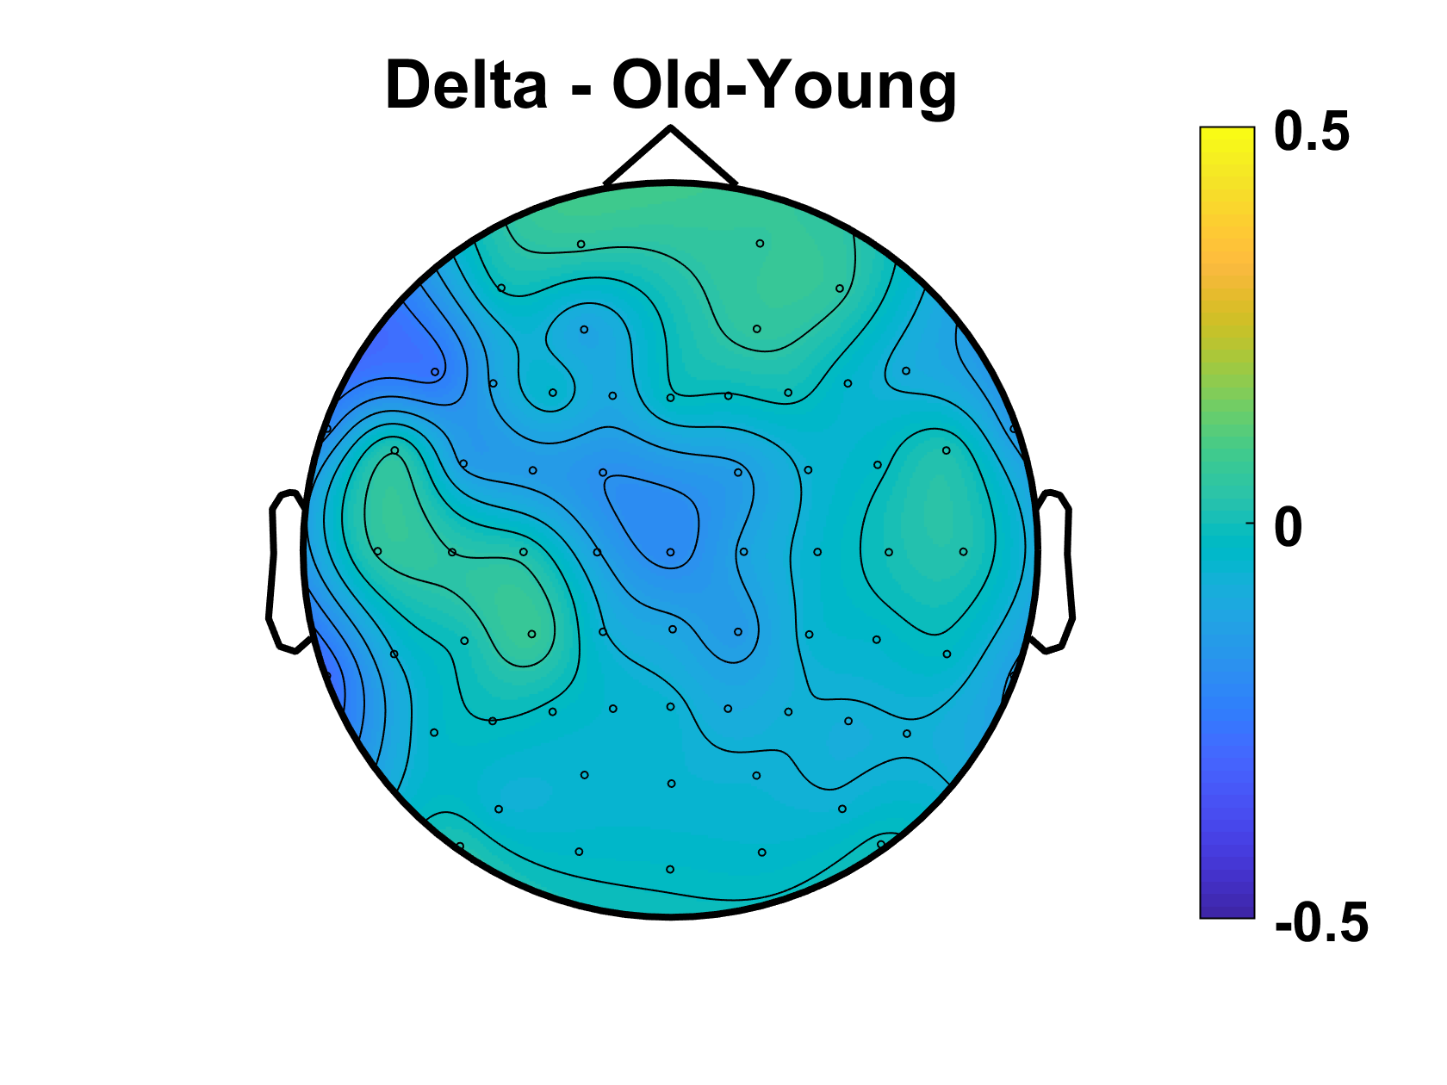
Power
No sig difference in Oz/((O1+O2)/2) ratio
p=.95
Notes:
REPLICATE TOPOGRAPHIES with all_osci (new scripts) – DONE (next slide)
+ differences old-young for each freq band - DONE

Slide 16
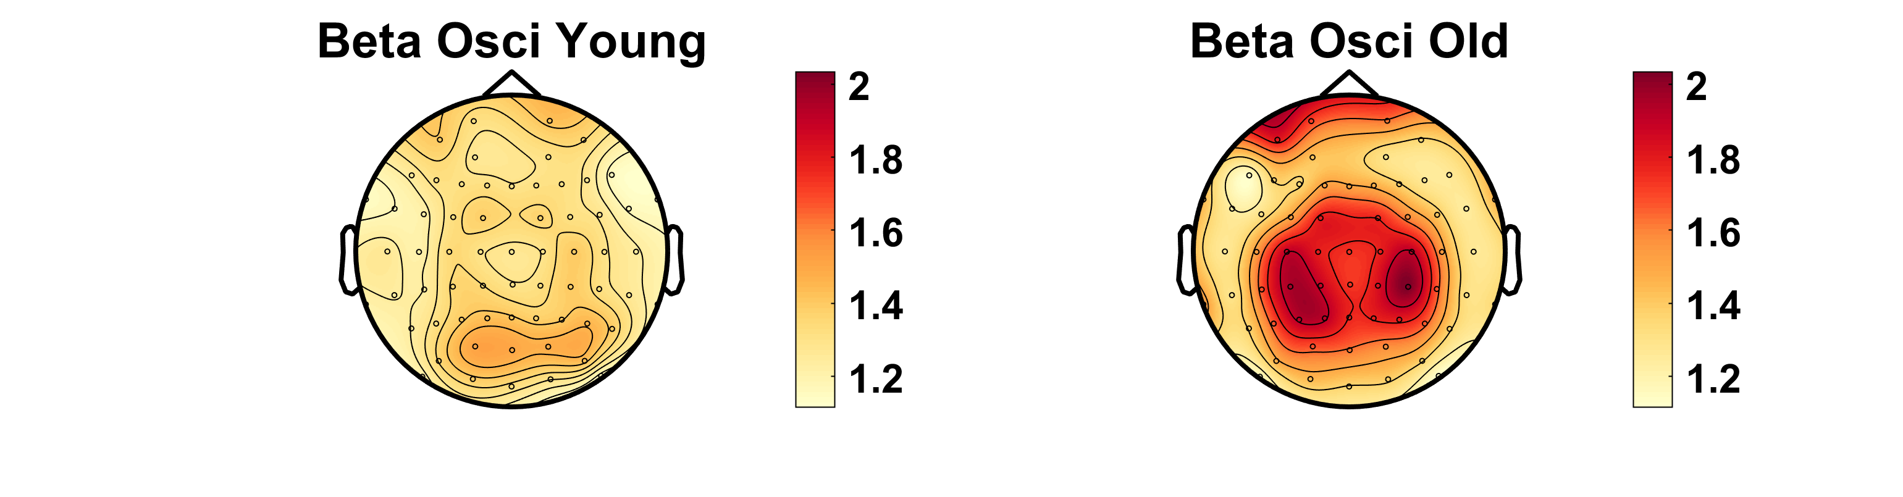
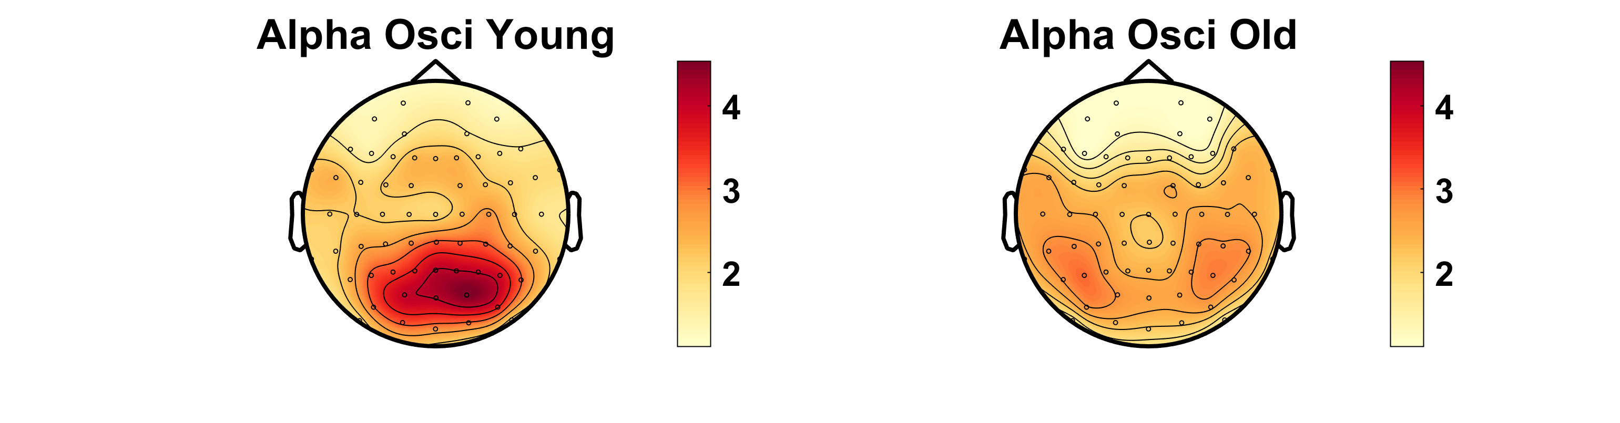
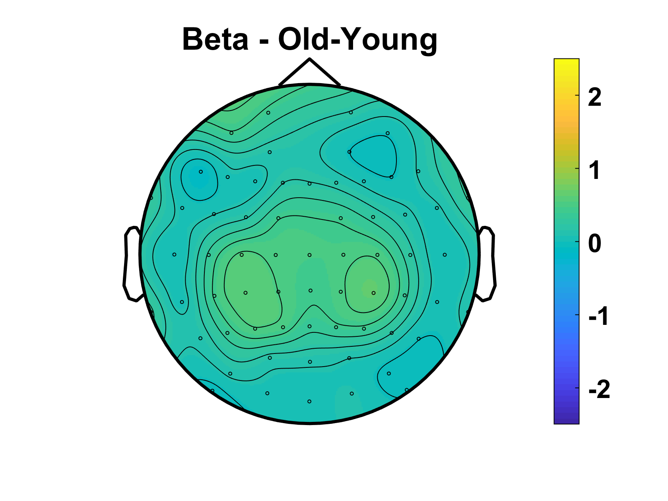
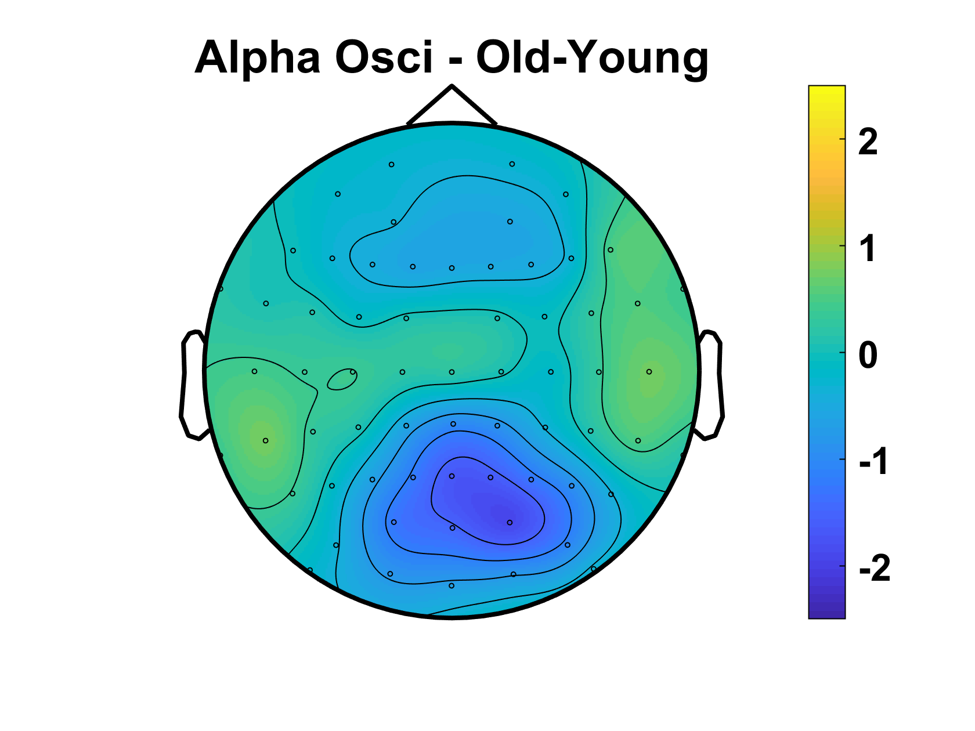
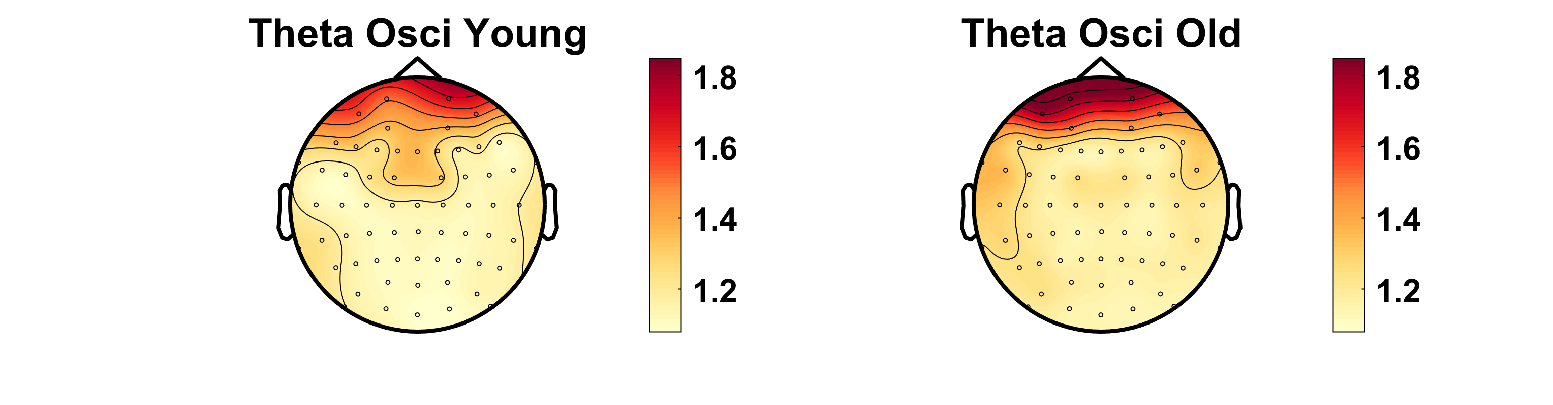
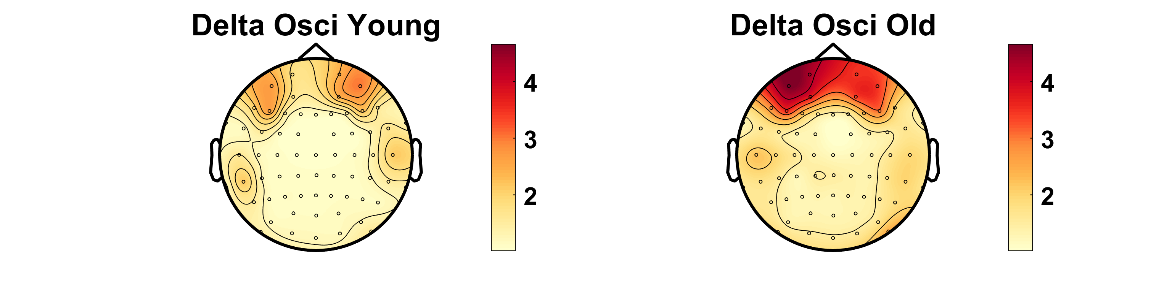
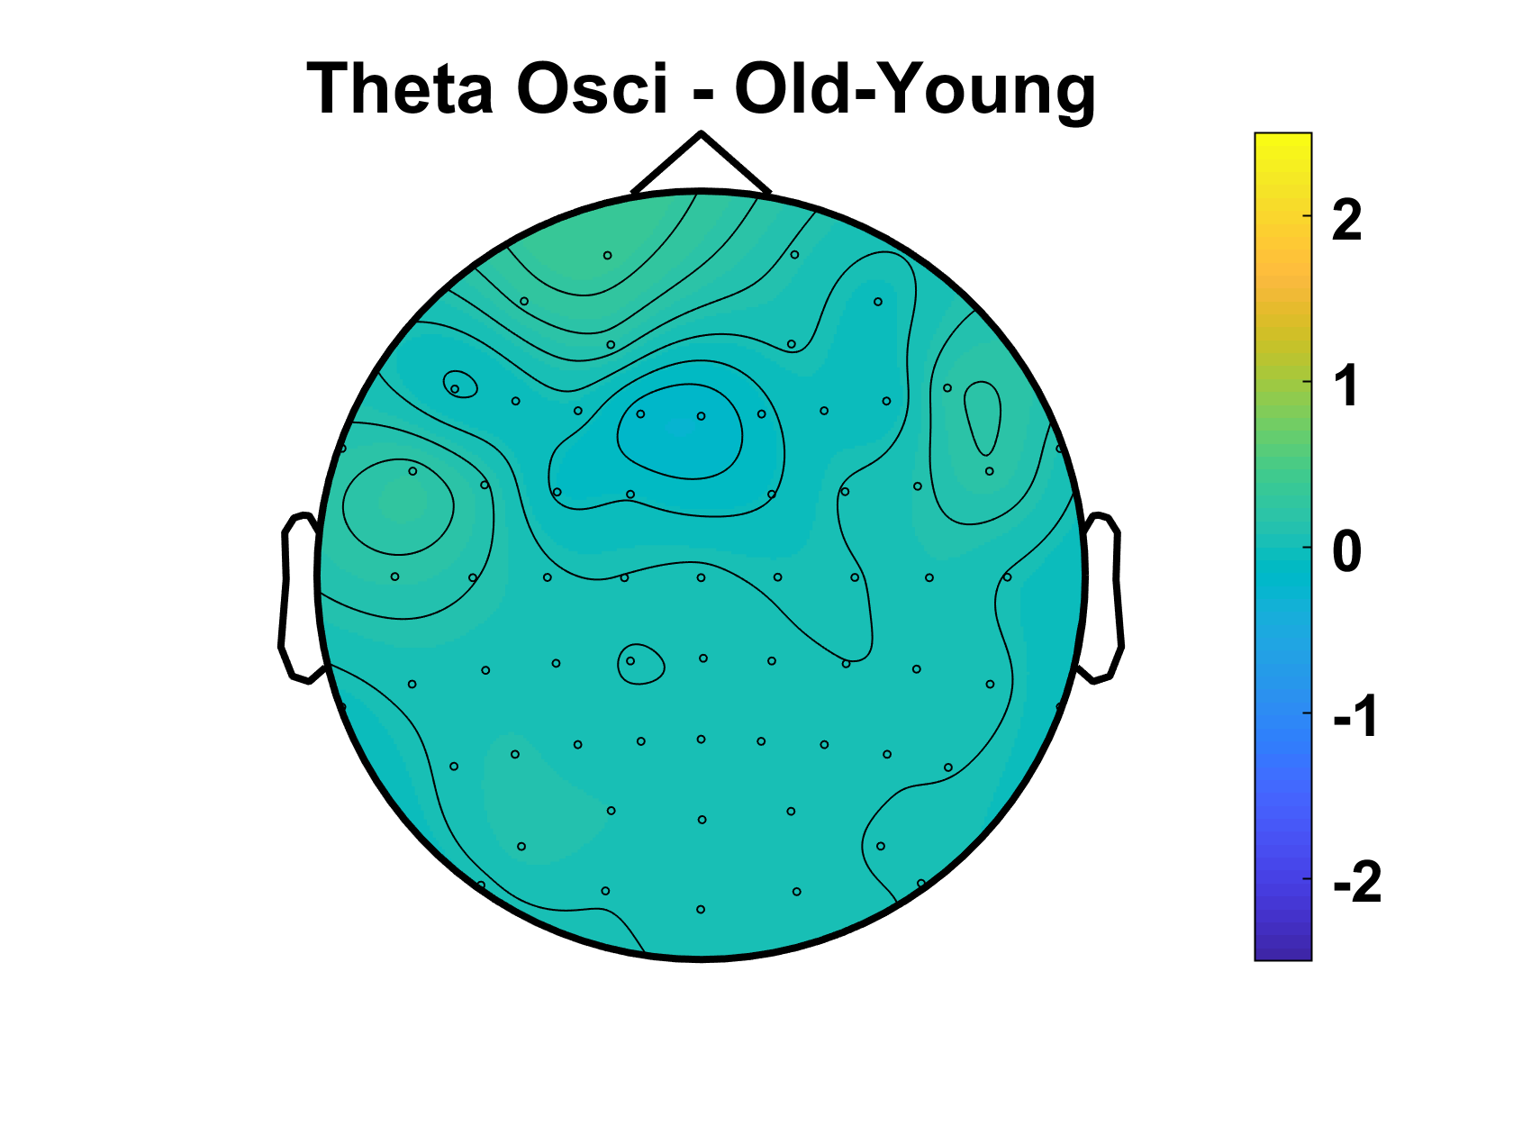
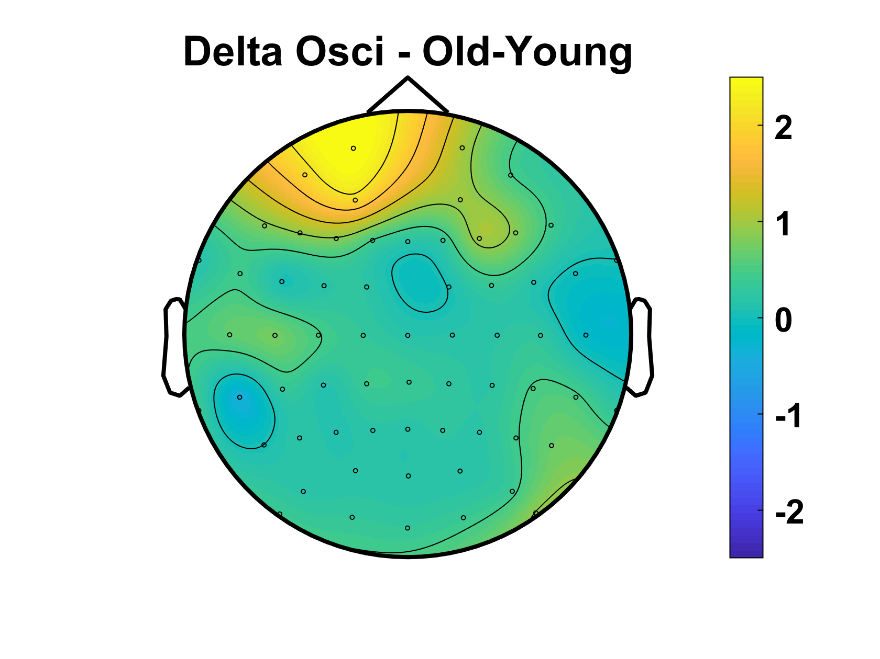
Oscillatory Component
No sig difference in Oz/((O1+O2)/2) ratio
p=.69
Notes:
REPLICATE TOPOGRAPHIES with all_osci (new scripts) – DONE (next slide)
+ differences old-young for each freq band - DONE

Slide 17
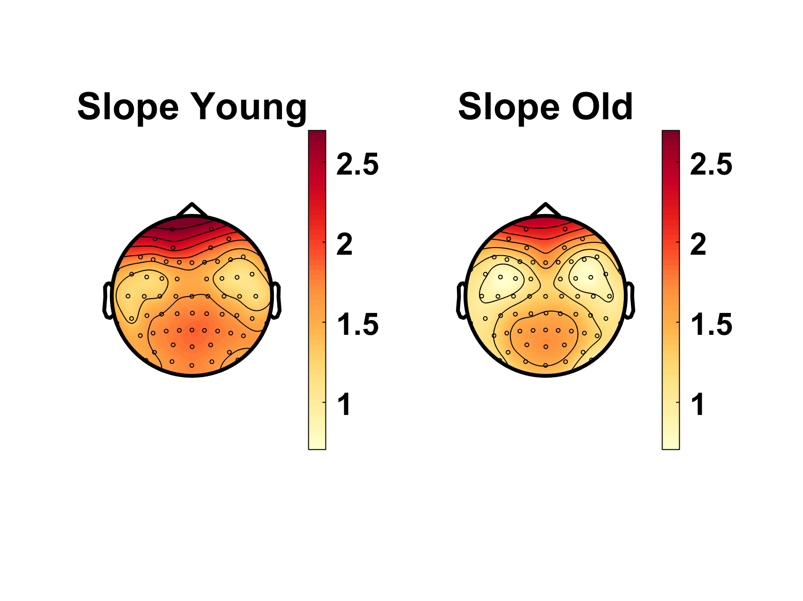
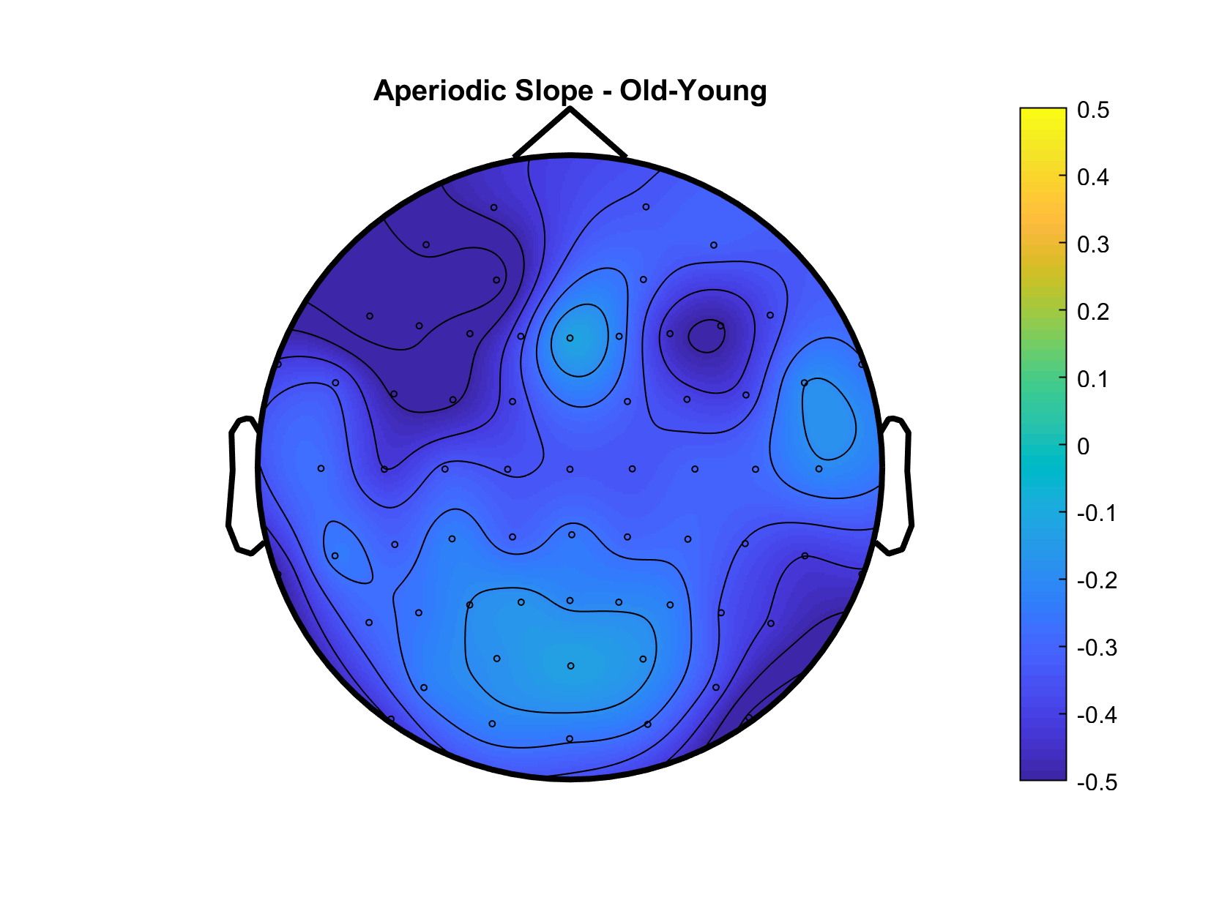
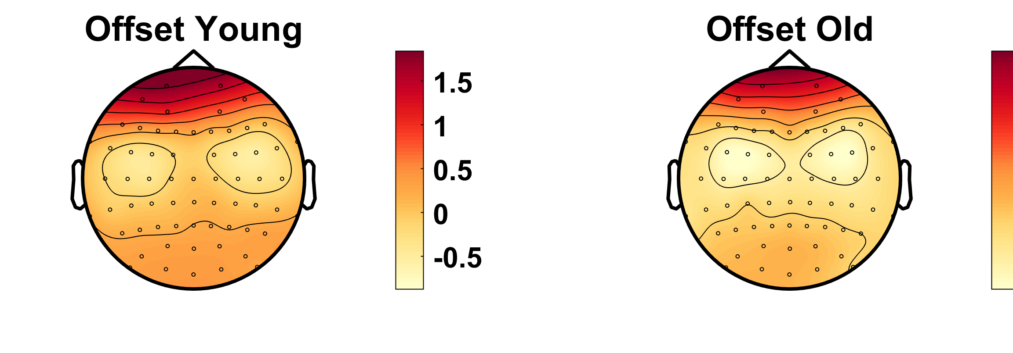
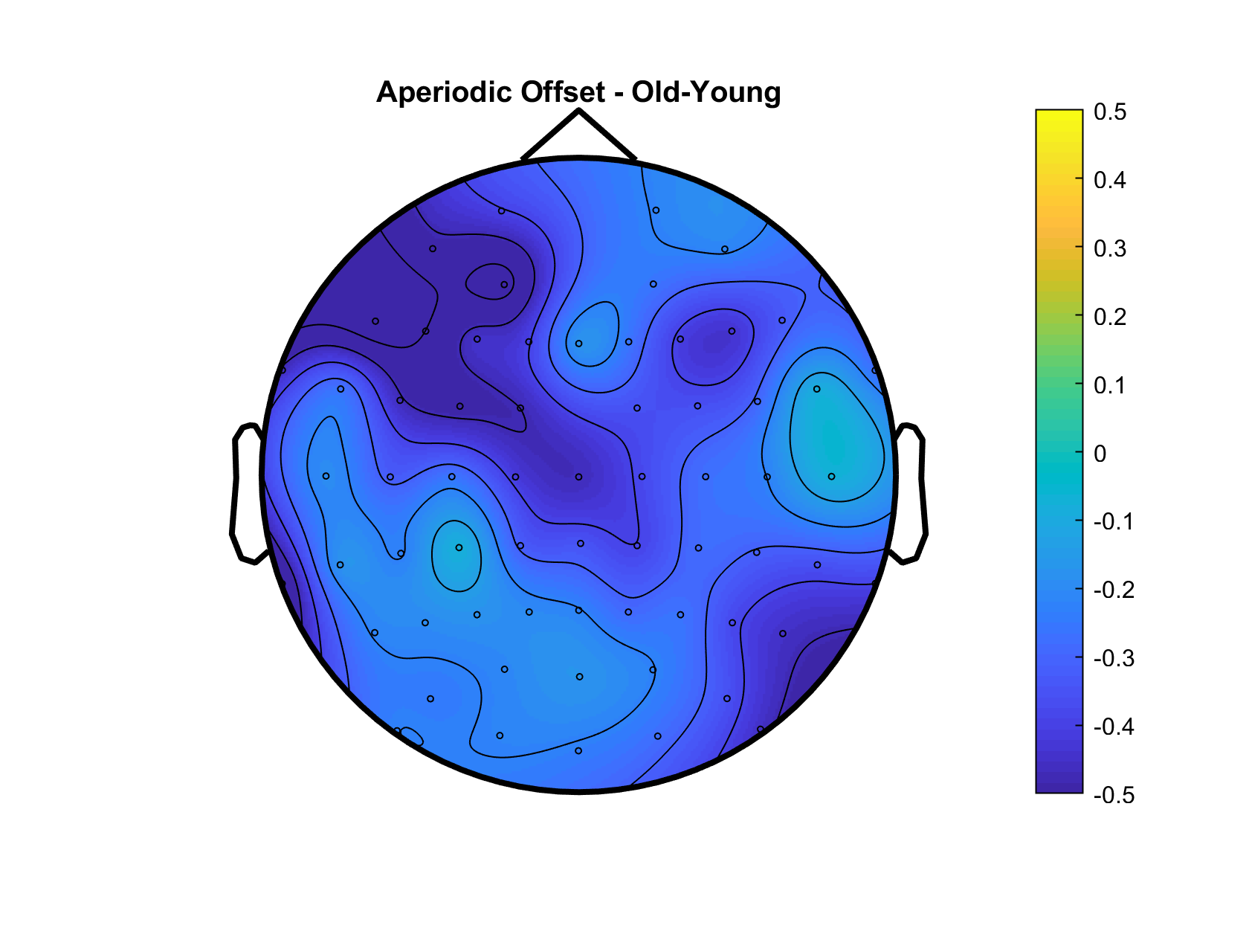
Aperiodic Slope – Younger 90% vs Older 90%
Aperiodic Offset – Younger 90% vs Older 90%
Notes:
Add old-young difference topograpjy - DONE

Slide 18
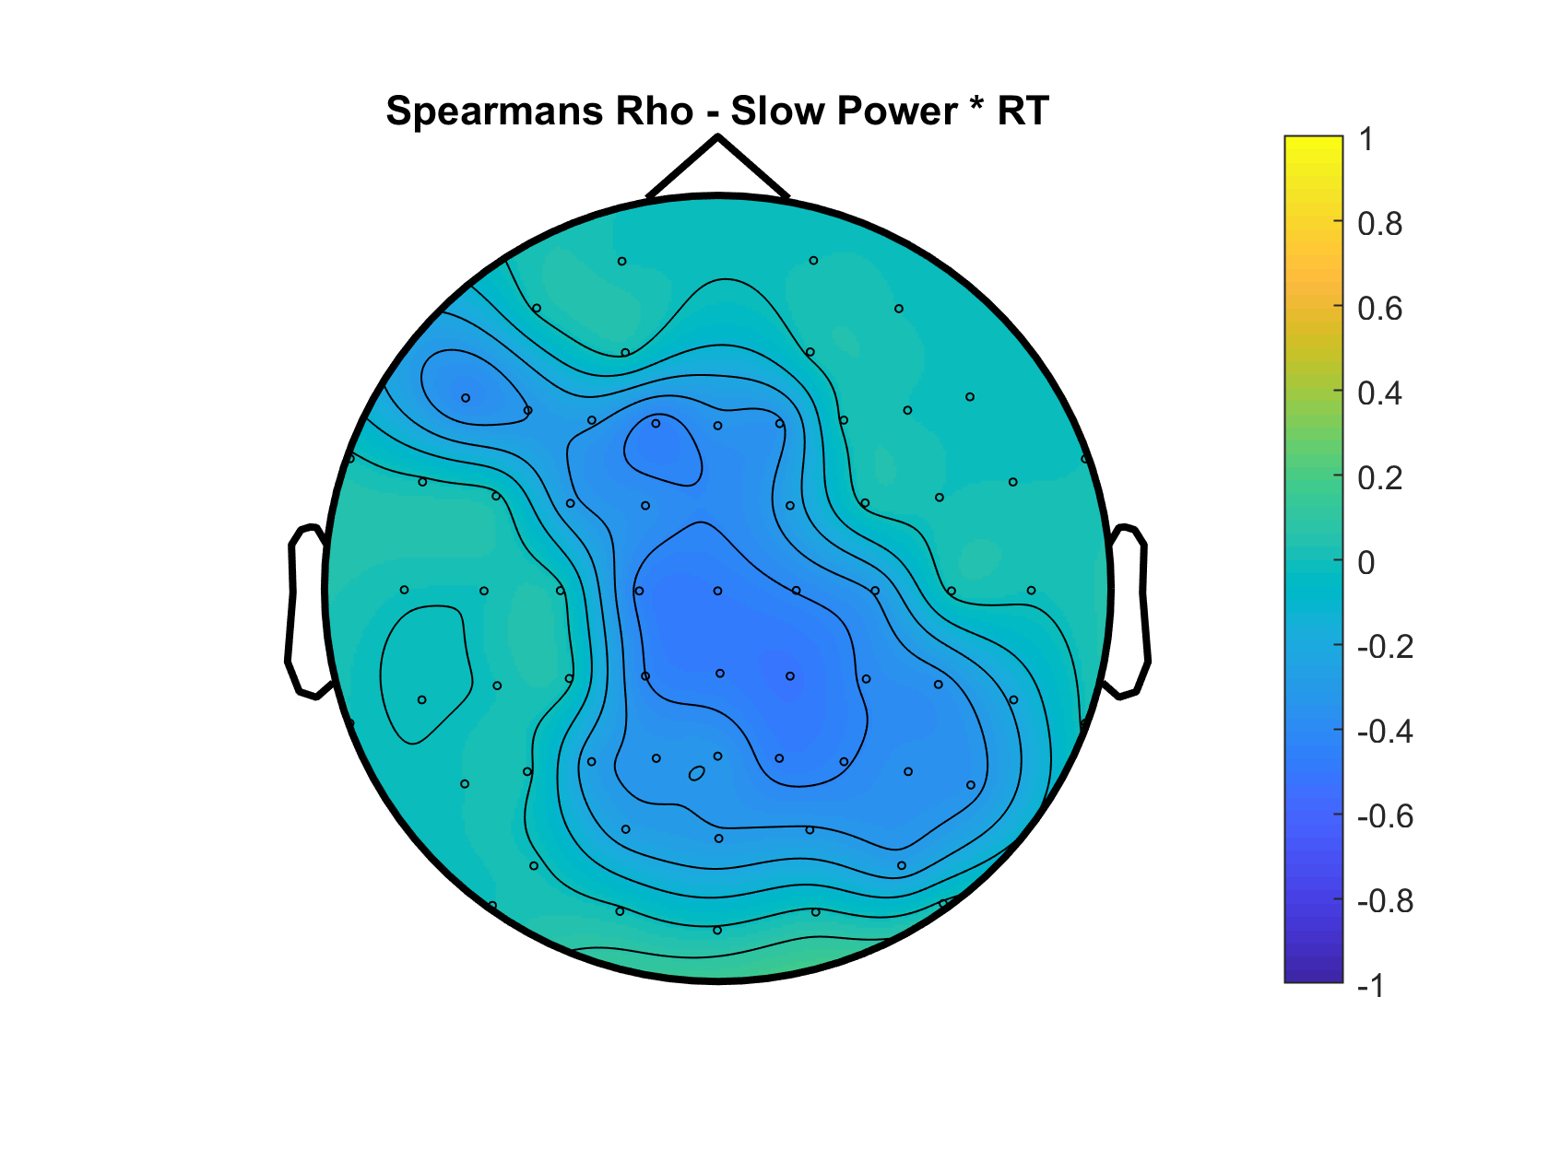
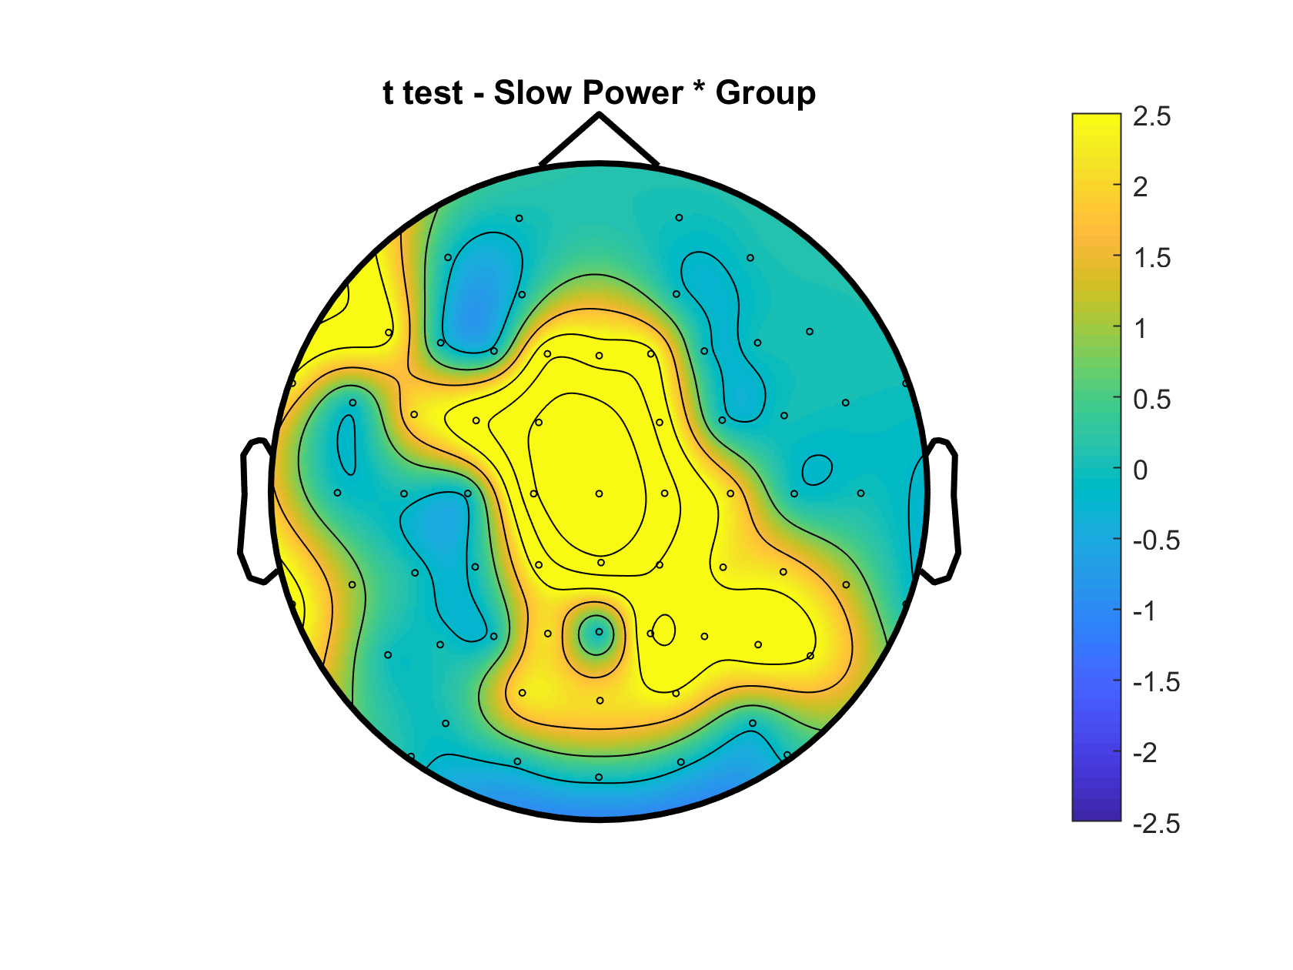
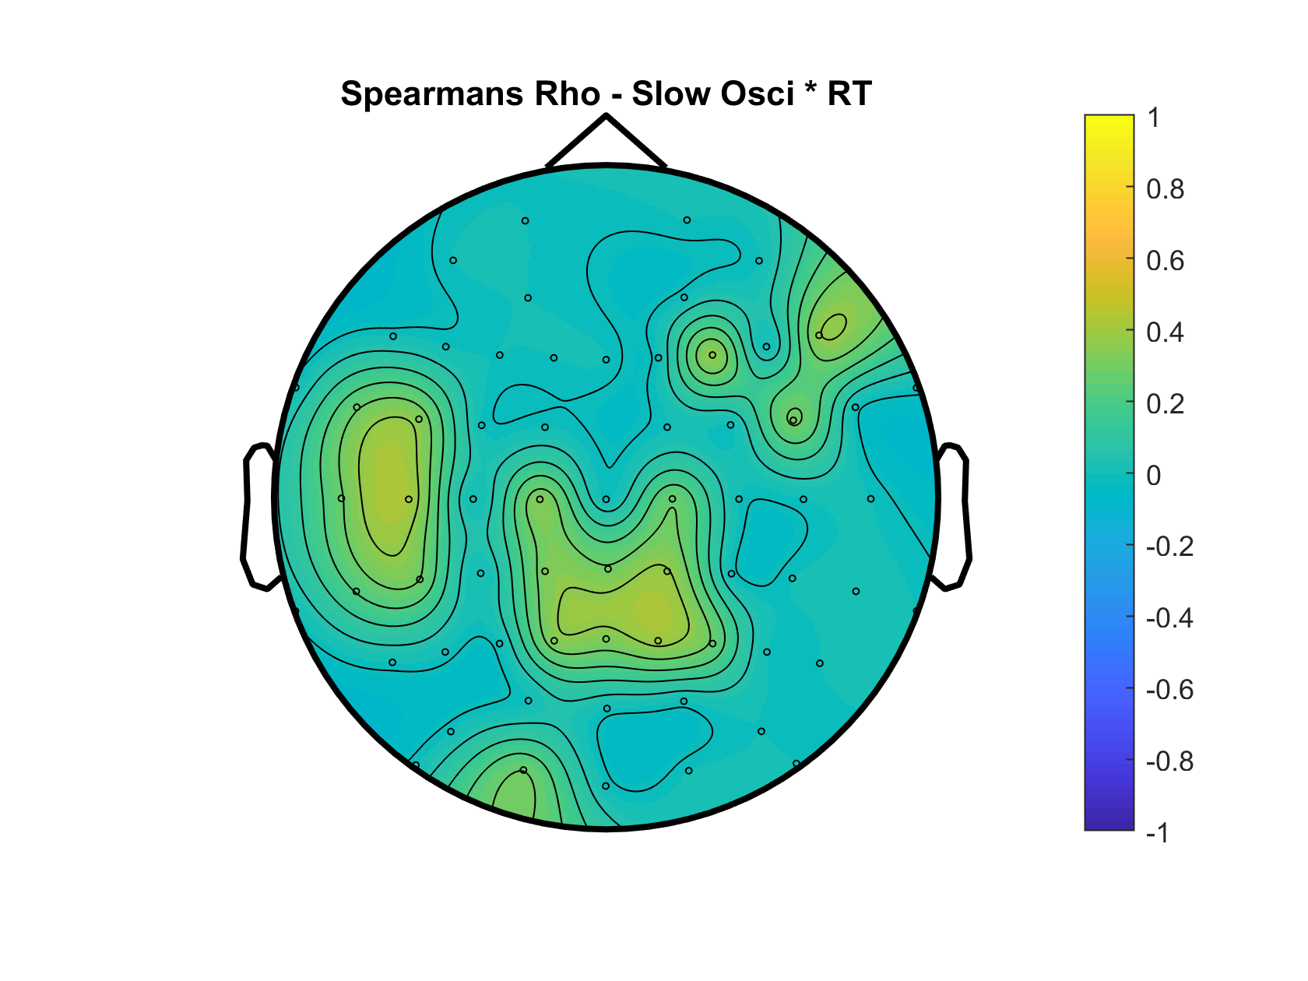
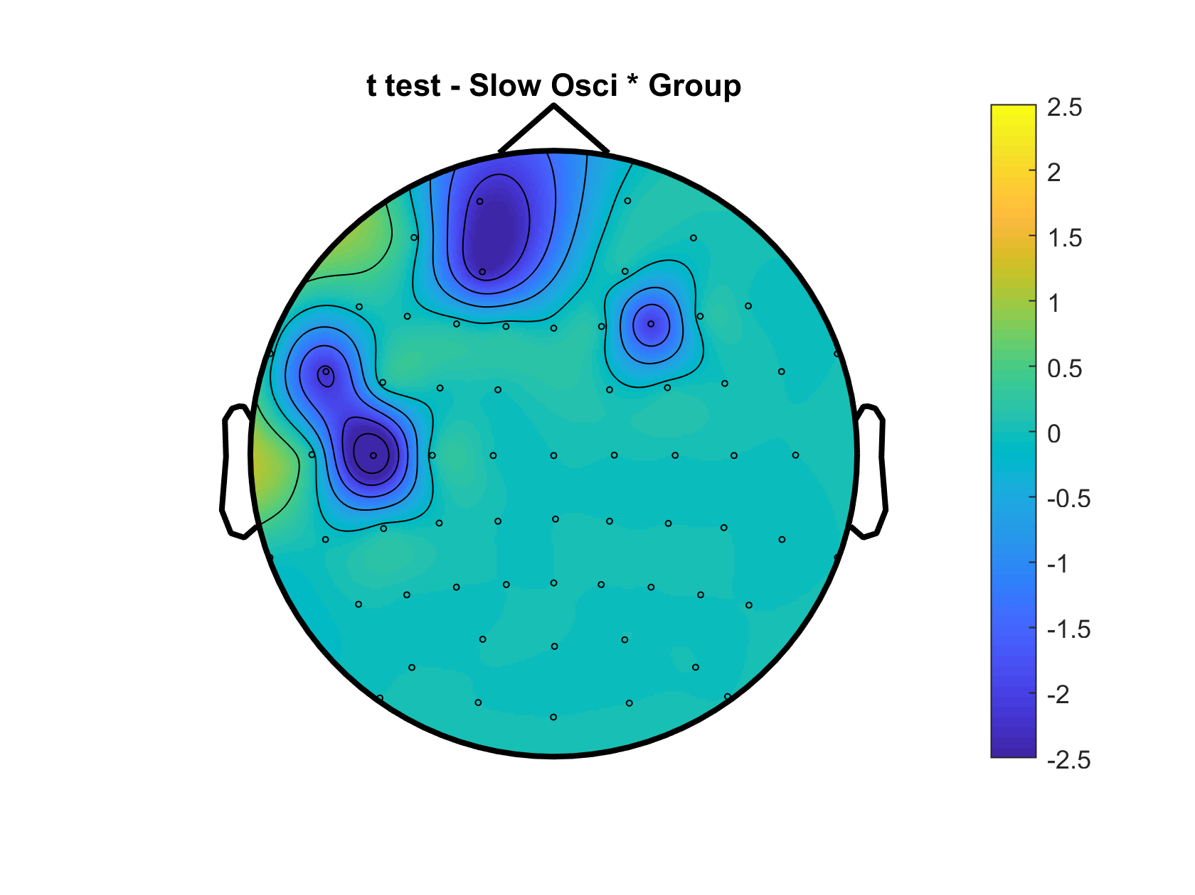
Slow Power
Slow Osci

Slide 19
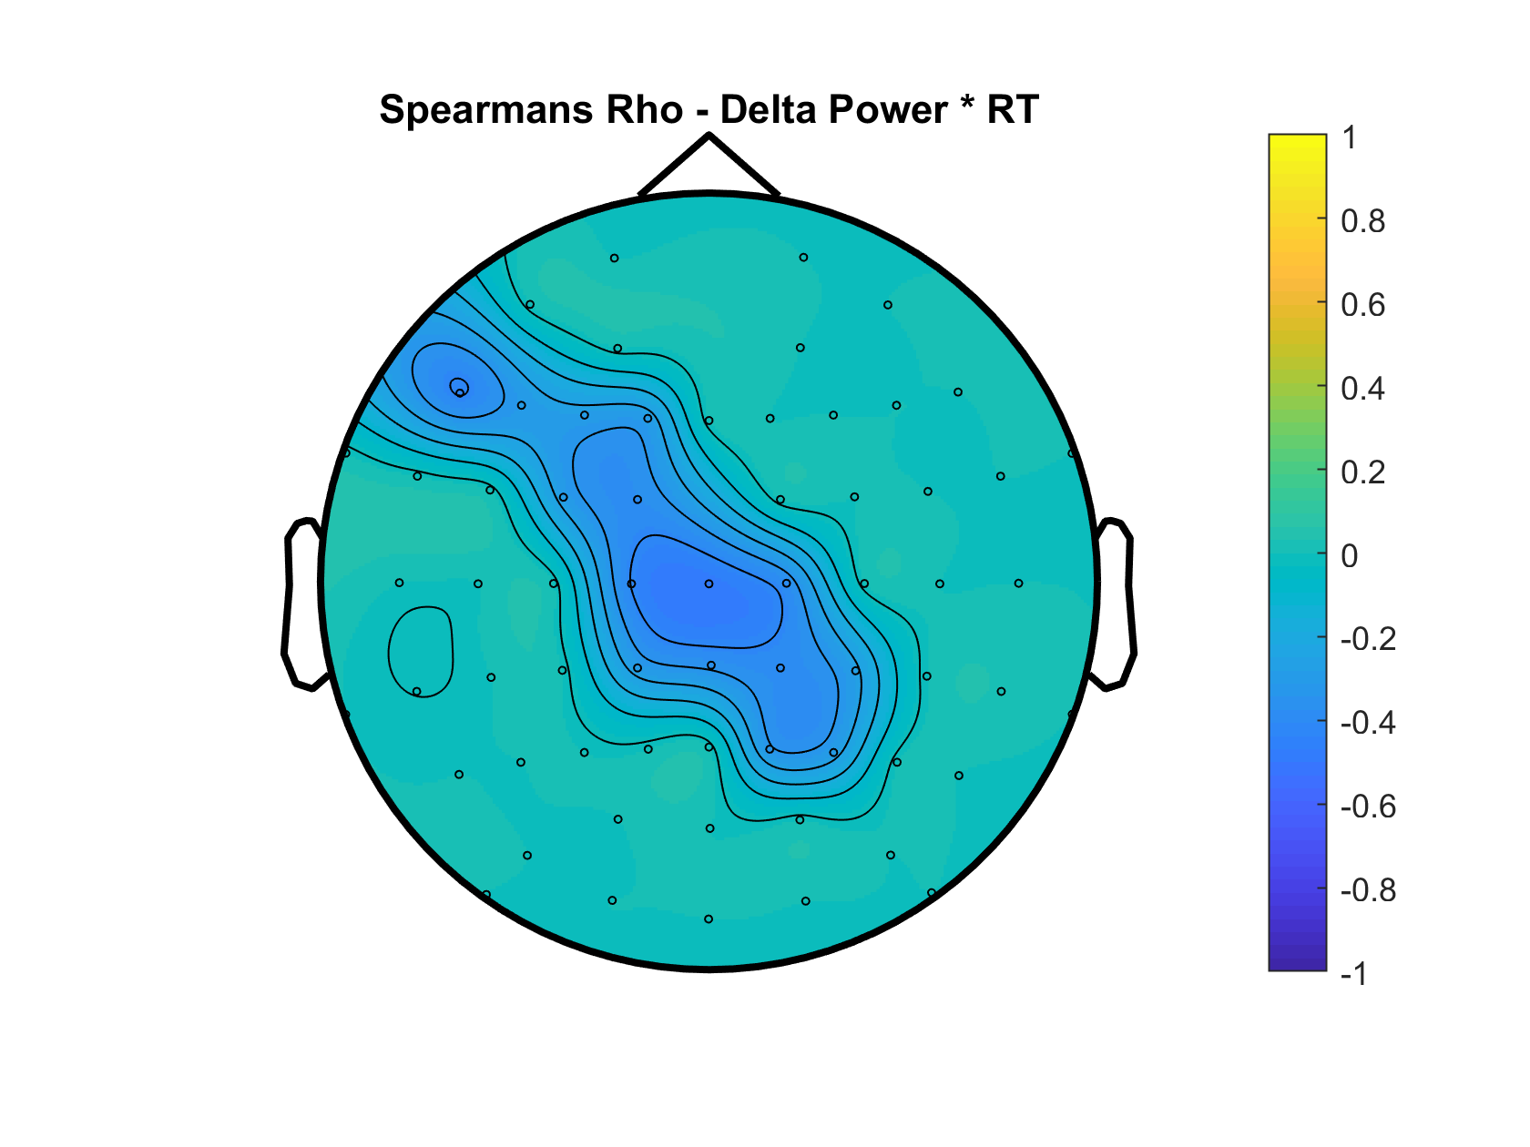
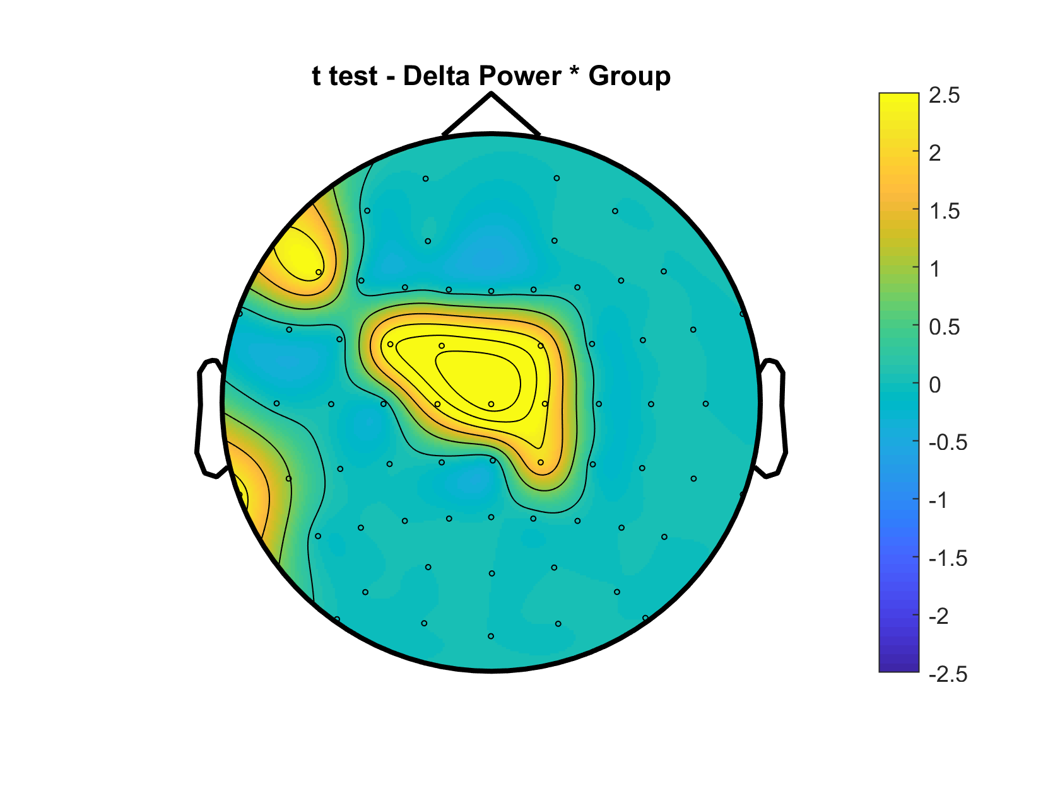
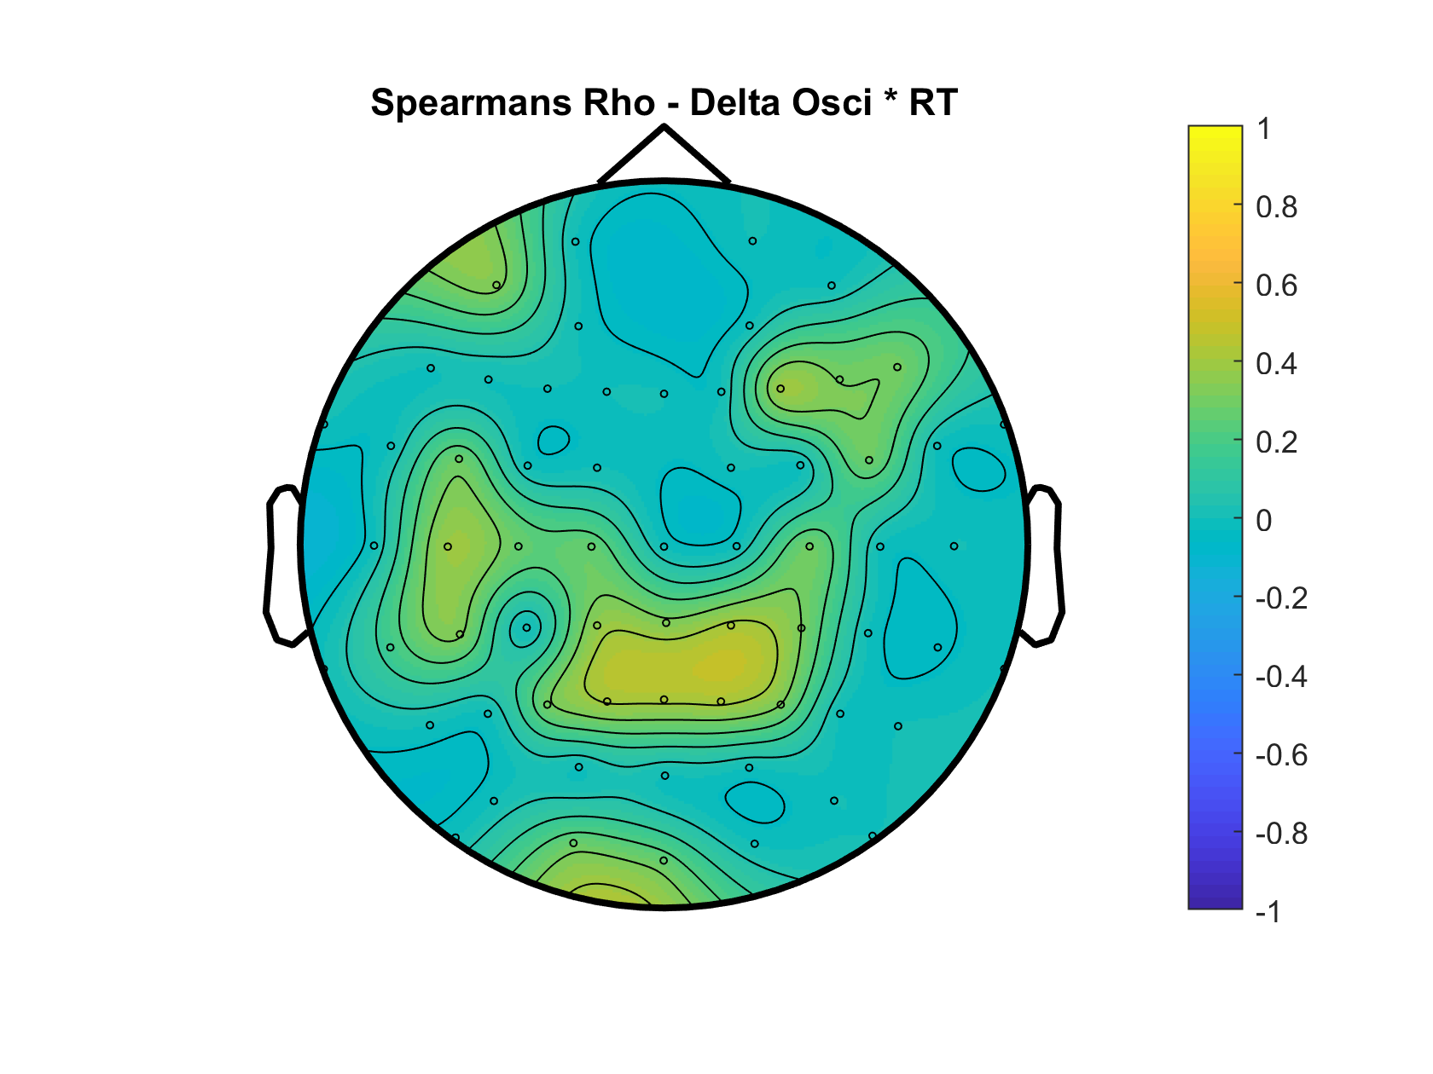
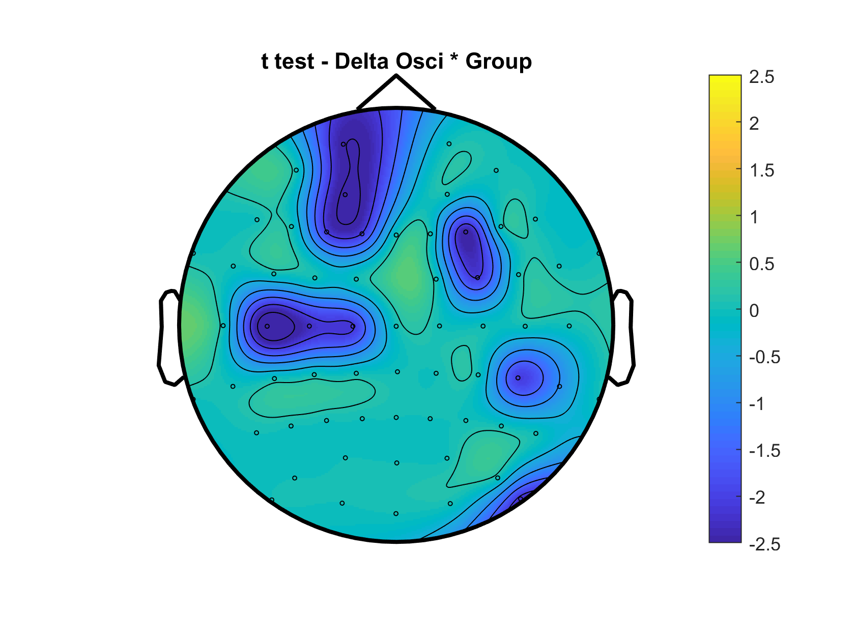
Delta Power
Delta Osci

Slide 20
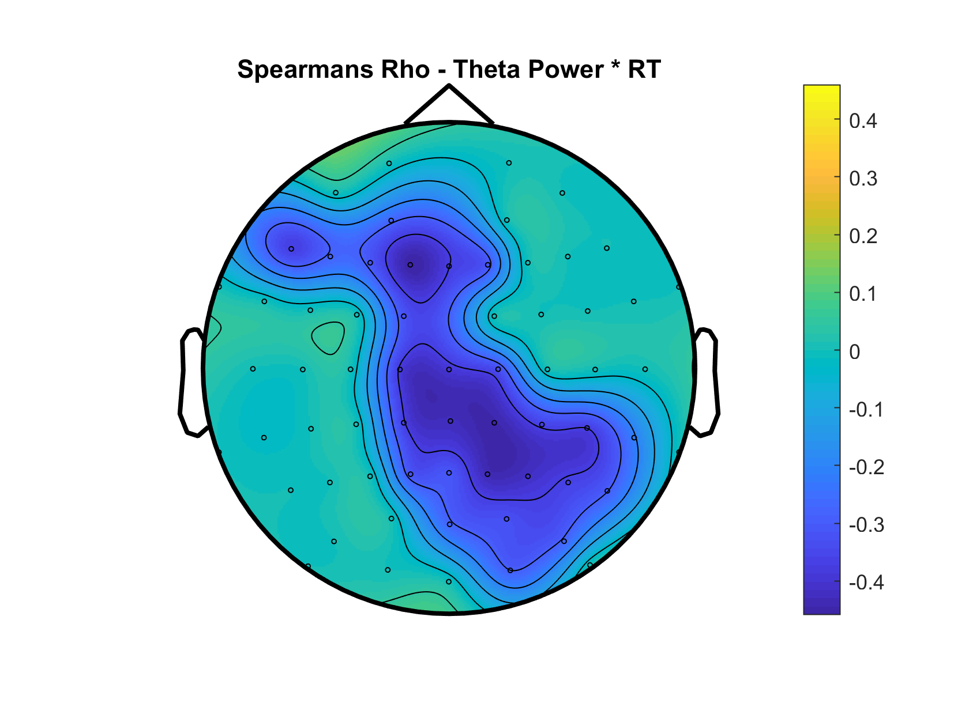
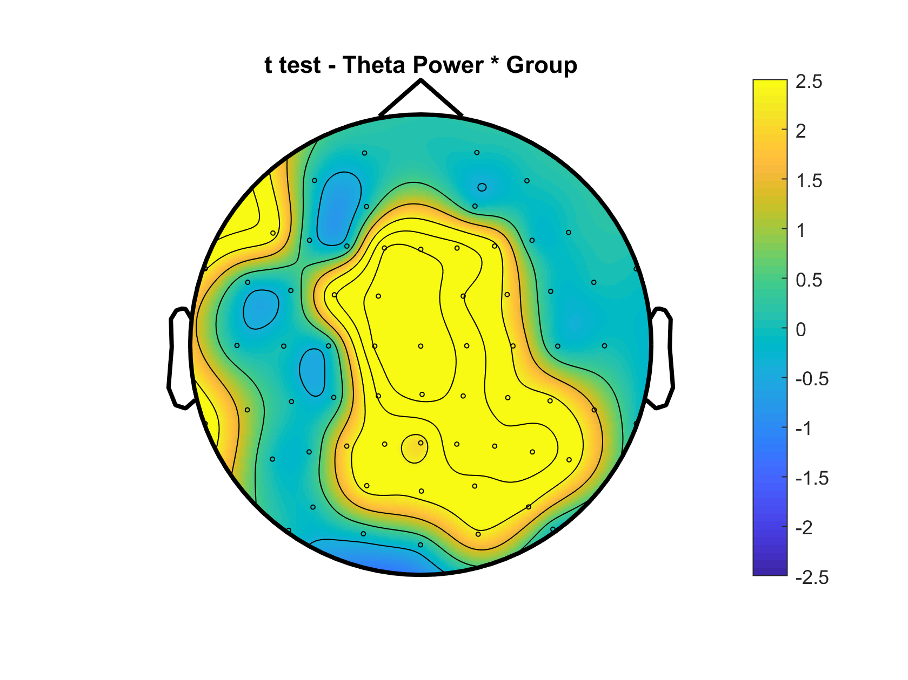
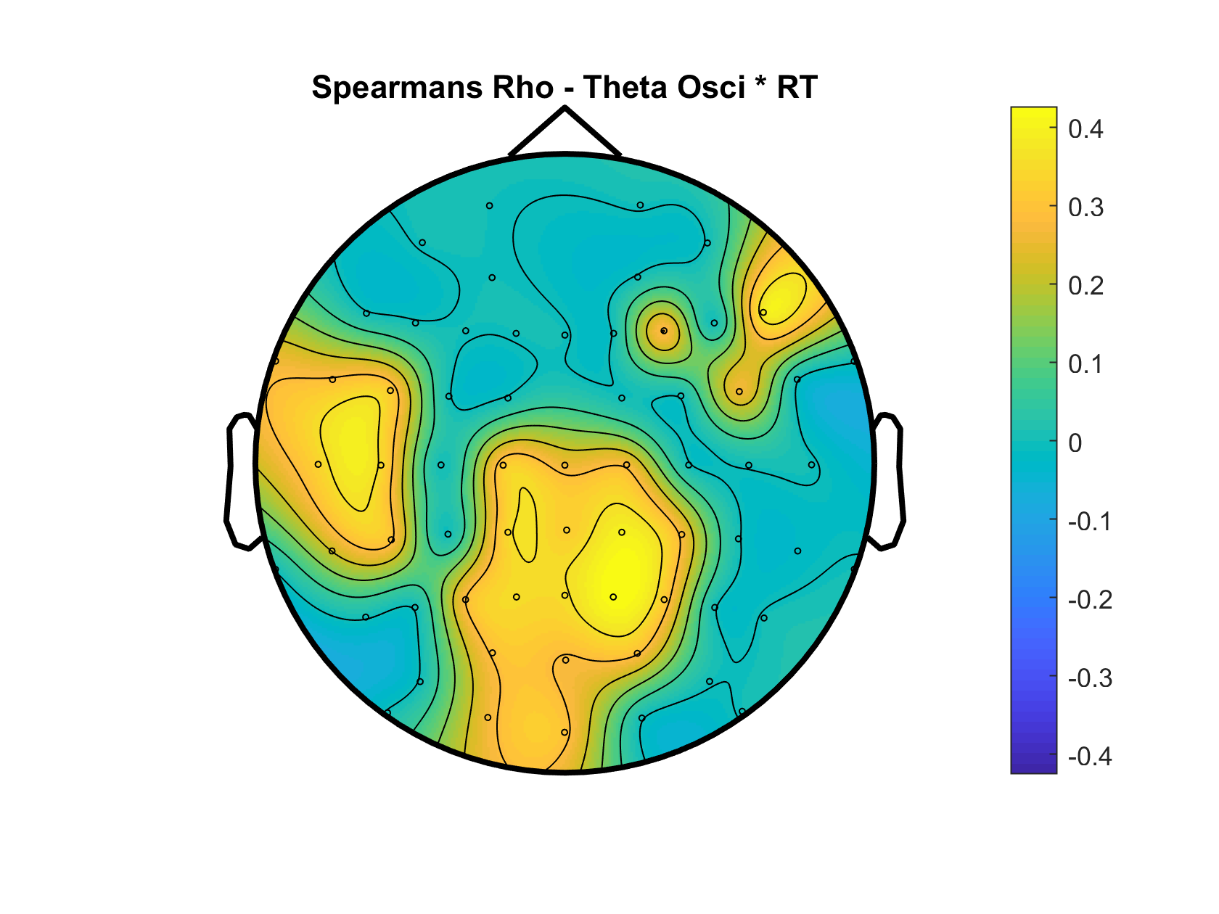
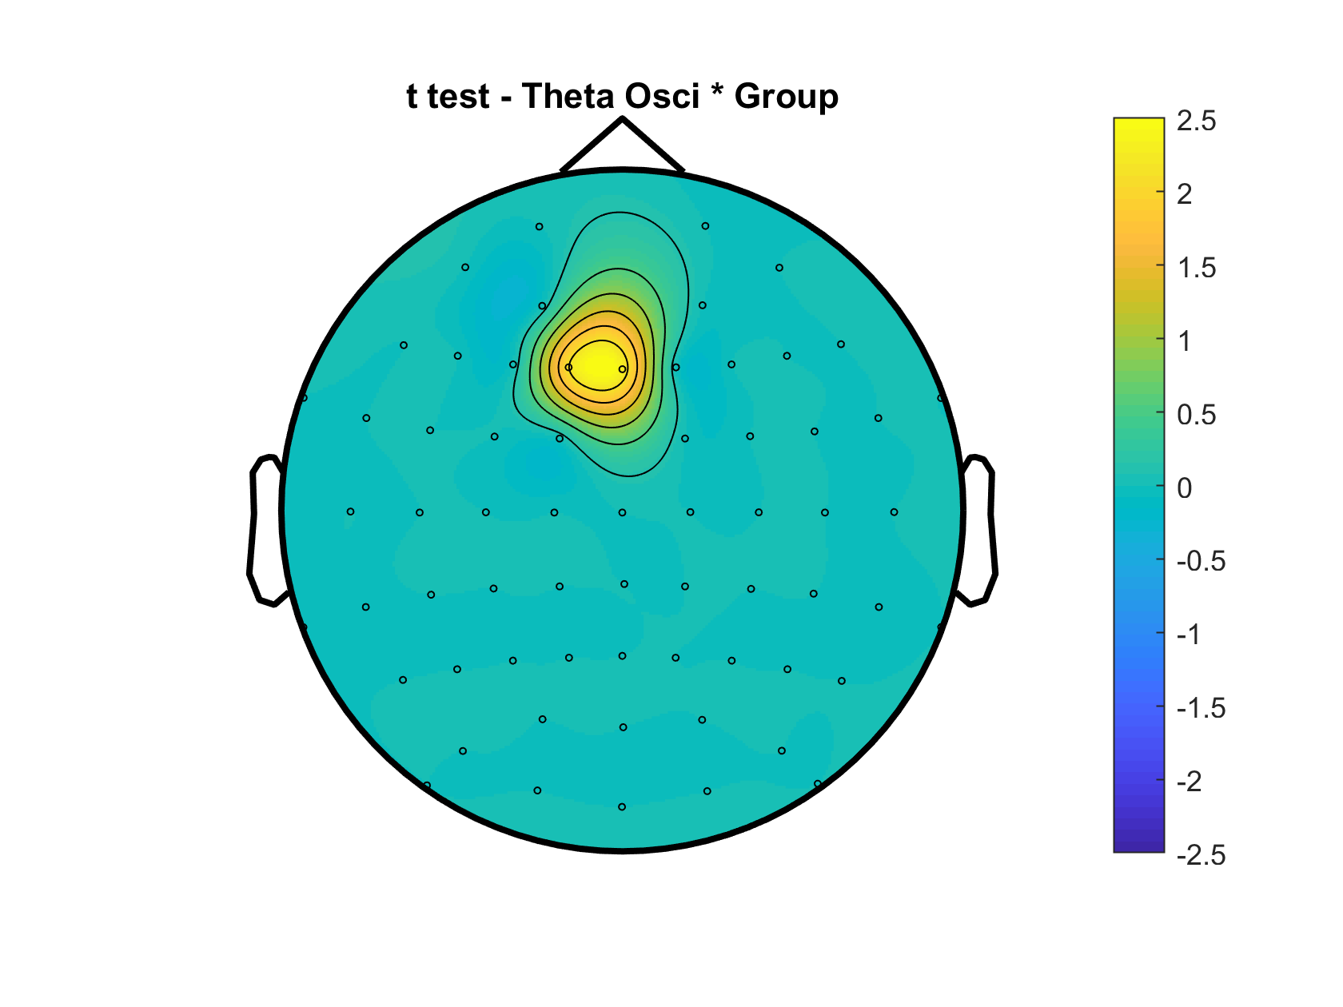
Theta Power
Theta Osci

Slide 21
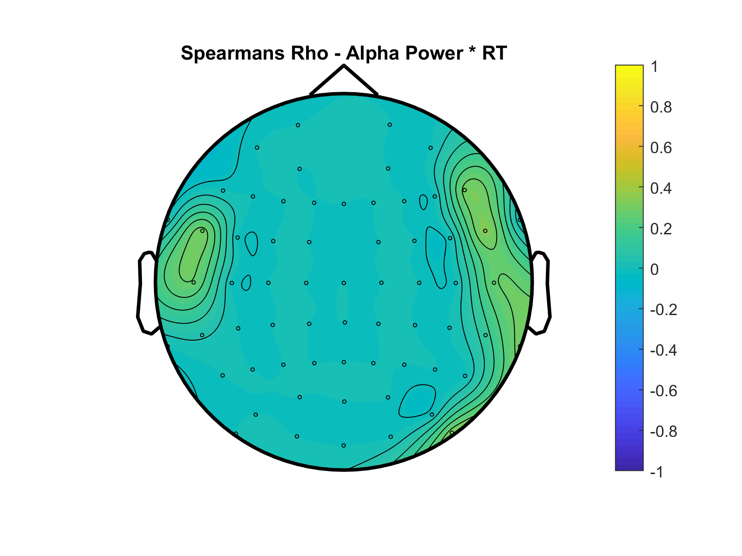
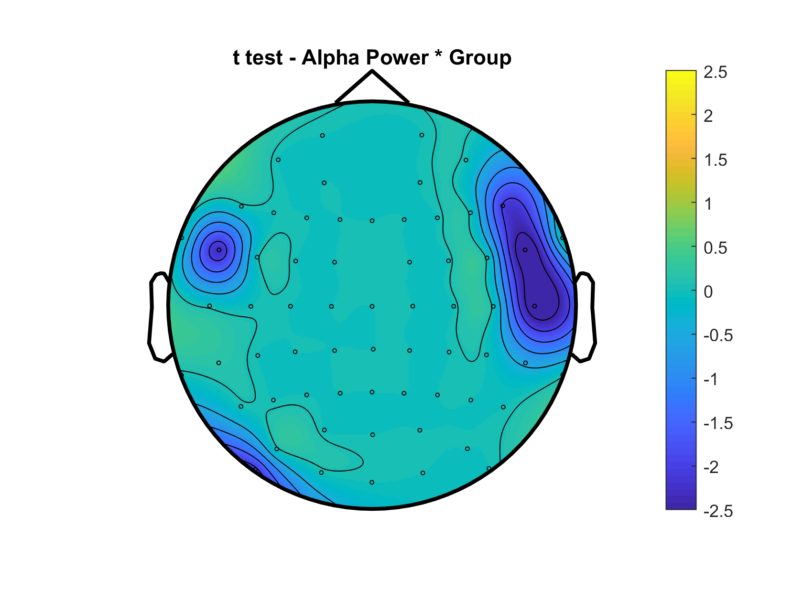
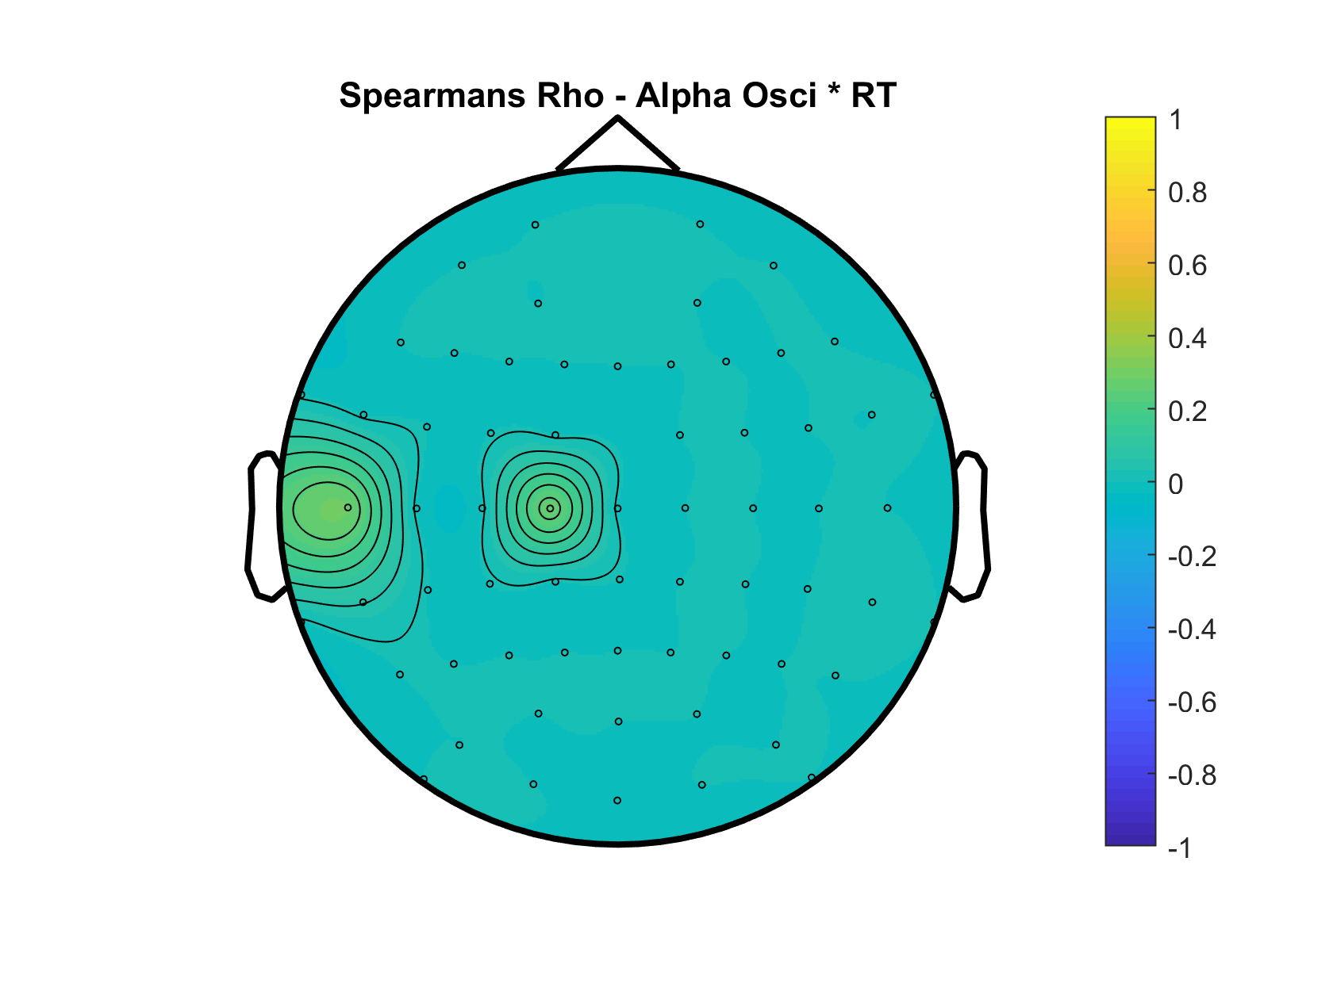
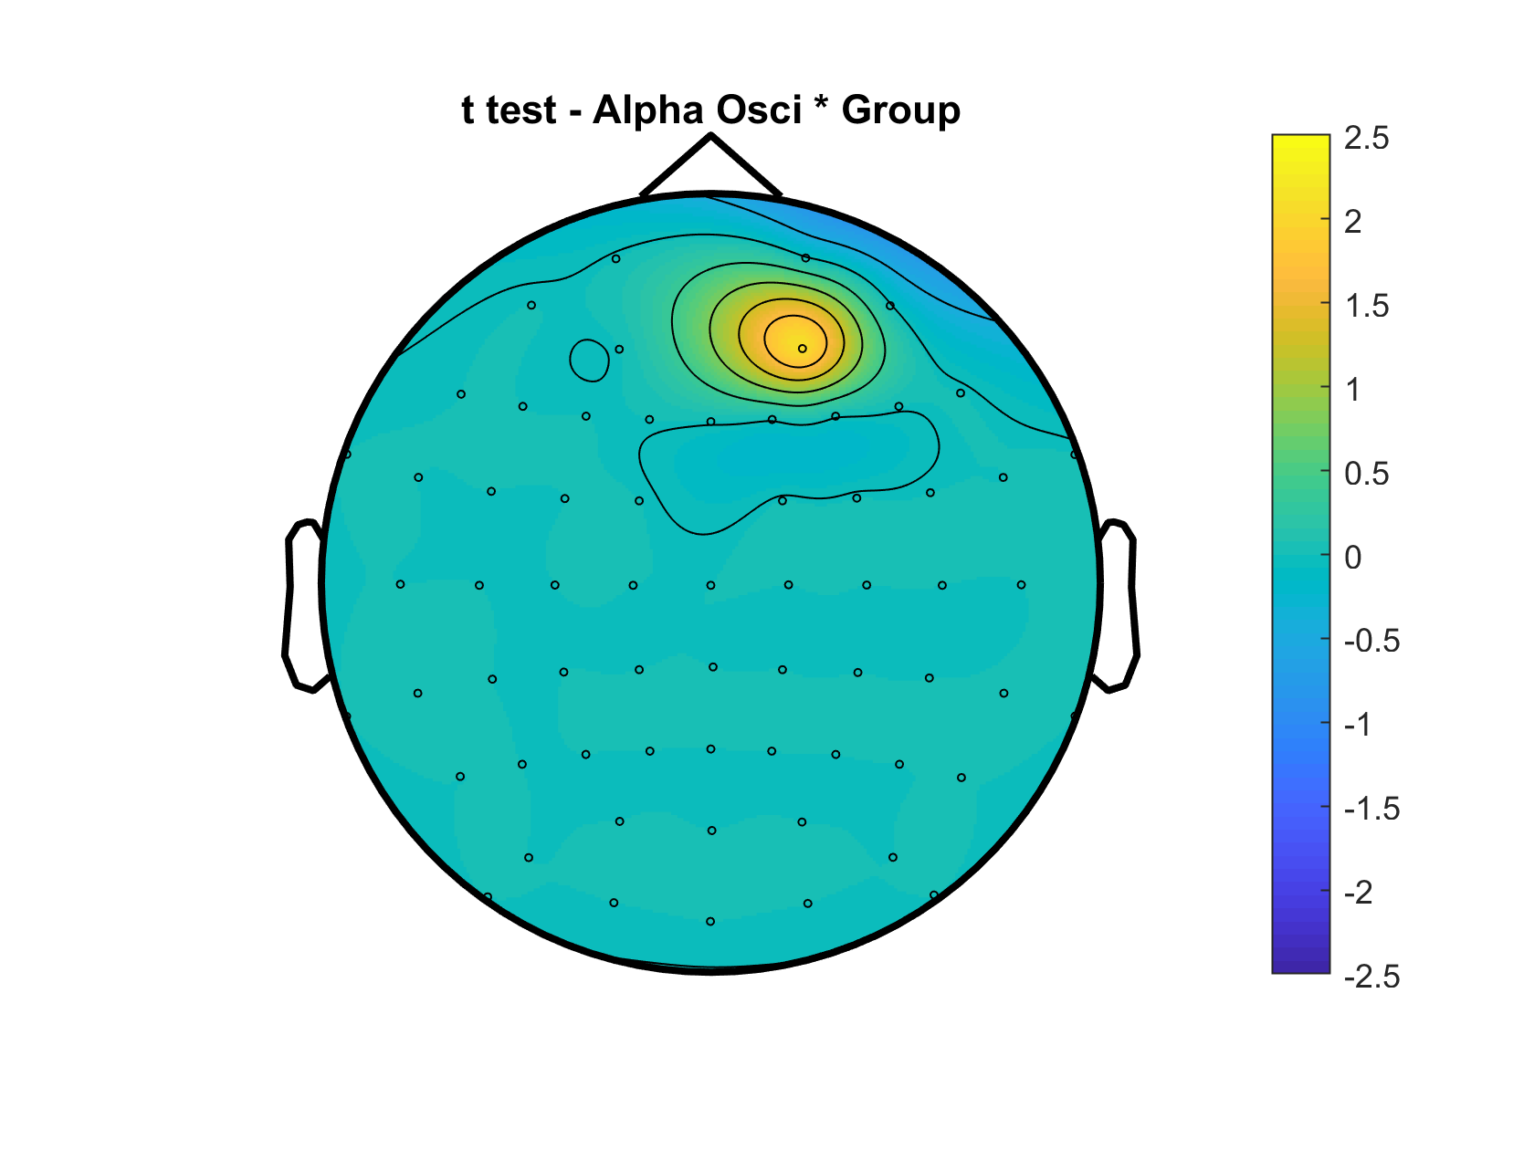
Alpha Power
Alpha Osci

Slide 22




Beta Power
Beta Osci

Slide 23

OLD SETTINGS

Slide 24

NEW SETTINGS

Slide 25

OLD SETTINGS
Notes:
Proportion of individuals with a peak in the alpha range and the theta/delta range (see all_detectedpeaks variable) – DONE (see slide 18)

Slide 26

NEW SETTINGS

Slide 27


Slide 28




Slow Peak Frequency – Younger 90% vs Older 90%
Slow Peak Amplitude – Younger 90% vs Older 90%
Notes:
Same scale if possible – DONE
Pull delta & theta together - DONE

Slide 29




Delta Peak Frequency – Younger 90% vs Older 90%
Delta Peak Amplitude – Younger 90% vs Older 90%
Notes:
Same scale if possible

Slide 30


Delta Peak Frequency – Younger 90% vs Older 90%
OLD CUTOFFS
Delta Peak Amplitude – Younger 90% vs Older 90%

Slide 31




Theta Peak Frequency – Younger 90% vs Older 90%
Theta Peak Amplitude – Younger 90% vs Older 90%

Slide 32


Theta Peak Frequency – Younger 90% vs Older 90%
OLD CUTOFFS
Theta Peak Amplitude – Younger 90% vs Older 90%

Slide 33




Alpha Peak Frequency – Younger 90% vs Older 90%
Alpha Peak Amplitude – Younger 90% vs Older 90%

Slide 34


Alpha Peak Frequency – Younger 90% vs Older 90%
OLD CUTOFFS
Alpha Peak Amplitude – Younger 90% vs Older 90%

Slide 35




Beta Peak Frequency – Younger 90% vs Older 90%
Old-Young
Beta Peak Amplitude – Younger 90% vs Older 90%
Old-Young

Slide 36


Beta Peak Frequency – Younger 90% vs Older 90%
OLD CUTOFFS
Beta Peak Amplitude – Younger 90% vs Older 90%

Slide 37

Young 90% Coherence

Slide 38

Old 90% Coherence

Slide 39

Difference TF – Young-Old

Slide 40

Young 90% Coherence

Slide 41

Old 90% Coherence

Slide 42

Difference TF – Young-Old

Slide 43

Young 90% Coherence

Slide 44

Old 90% Coherence

Slide 45

Difference TF – Young-Old

Slide 46





Slide 47





Slide 48





Slide 49





Slide 50





Slide 51





Slide 52





Slide 53





Slide 54




Slide 55





Slide 56





Slide 57





Slide 58





Slide 59





Slide 60





Slide 61





Slide 62





Slide 63





Slide 64





Slide 65





